Slide 1

Bayes MCMC Models
Steve Elston
Copyright 2018, 2019, 2020, 2021, 2022, 2023 2024, 2025, Stephen F Elston. All rights reserved.

Slide 2
Introduction
How can we extend Bayes models to more complex problems?
For simple problems we can use a conjugate prior and posterior
What about problems with complex likelihood?
Need to perform sampling to compute approximation of posterior
Highly efficient sampling methods required for complex problems

Slide 3
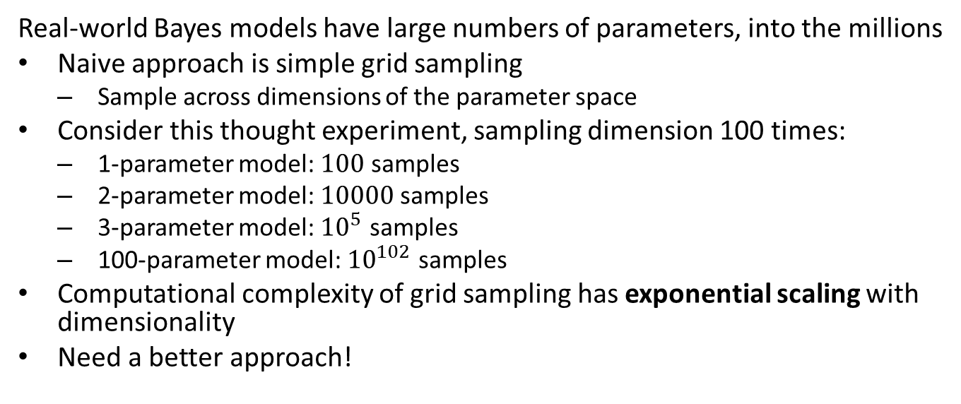
Grid Sampling Cannot Scale!
Real-world Bayes models have large numbers of parameters, into the millions
Naive approach is simple grid sampling
Sample across dimensions of the parameter space
Consider this thought experiment, sampling dimension 100 times:
1-parameter model: $100$ samples
2-parameter model: $10000$ samples
3-parameter model: ${10}^{5}$ samples
100-parameter model: ${10}^{102}$ samples
Computational complexity of grid sampling has exponential scaling with dimensionality
Need a better approach!

Slide 4
Scaling Bayesian models
How can we scale Bayesian models to 1000s of parameters?
Variational methods
Based on variational calculus
A very effective and highly scalable method
But, mathematically difficult to apply as a general solution
Details beyond our scope
Markov Chain Monte Carlo (MCMC)
A simple and reliable method for Bayesian inference
Trade-off variance of estimates and computer power for ease of implementation
Our focus in this course

Slide 5
Introduction to Markov Chain Monte Carlo
Large-scale Bayesian models need highly efficient sampling methods
Markov chain Monte Carlo (MCMC) sampling is efficient and scalable
Rather than sampling on a grid, MCMC methods sample distributions efficiently
Sample higher density regions of posterior with higher probability
Requires effort to understand how the algorithm works
What to do when things go wrong

Slide 6
Markov Processes

Slide 7
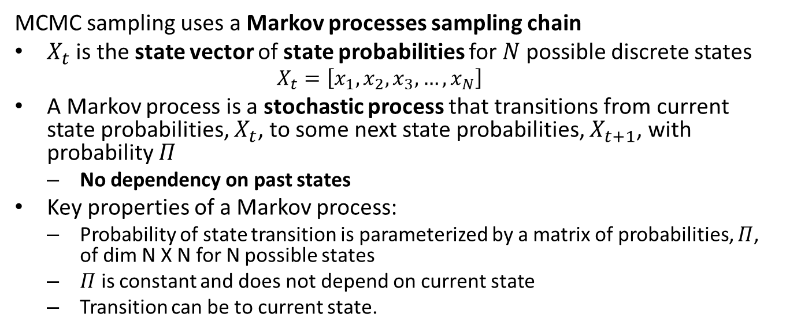
What is a Markov process?
MCMC sampling uses a Markov processes sampling chain
$X_{t}$ is the state vector of state probabilities for $N$ possible discrete states
$$X_{t}=\left[x_{1},x_{2},x_{3},…,x_{N}\right]$$
A Markov process is a stochastic process that transitions from current state probabilities, $X_{t}$, to some next state probabilities, $X_{t+1}$, with probability $Π$
No dependency on past states
Key properties of a Markov process:
Probability of state transition is parameterized by a matrix of probabilities, $Π$, of dim N X N for N possible states
$Π$ is constant and does not depend on current state
Transition can be to current state.

Slide 8
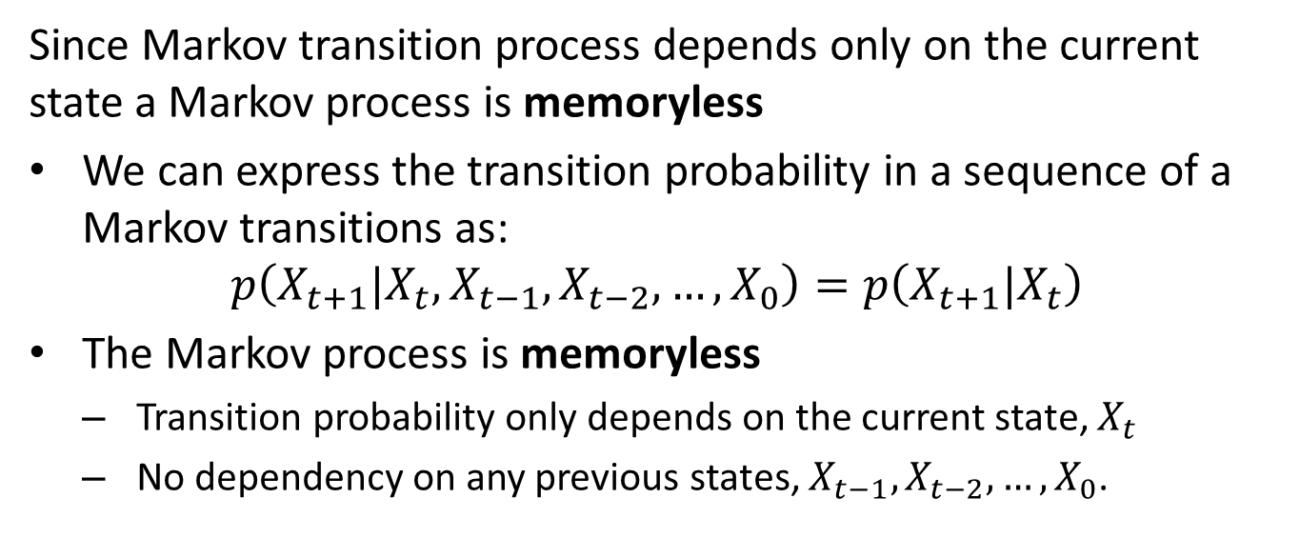
What is a Markov process?
Since Markov transition process depends only on the current state a Markov process is memoryless
We can express the transition probability in a sequence of a Markov transitions as:
$$p\left(X_{t+1}|X_{t},X_{t−1},X_{t−2},…,X_{0}\right)=p\left(X_{t+1}|X_{t}\right)$$
The Markov process is memoryless
Transition probability only depends on the current state, $X_{t}$
No dependency on any previous states, $X_{t−1},X_{t−2},…,X_{0}$.

Slide 9
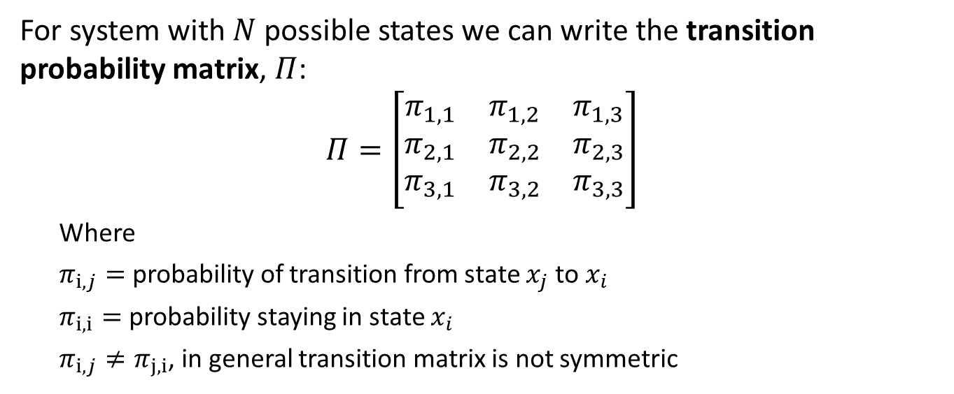
What is a Markov process?
For system with $N$ possible states we can write the transition probability matrix, $Π$:
$$Π=\left[\begin{matrix}π_{1,1} & π_{1,2} & π_{1,3} \\ π_{2,1} & π_{2,2} & π_{2,3} \\ π_{3,1} & π_{3,2} & π_{3,3}\end{matrix}\right]$$
Where
$π_{i,j}=$ probability of transition from state $x_{j}$ to $x_{i}$
$π_{i,i}=$ probability staying in state $x_{i}$
$π_{i,j}≠π_{j,i}$, in general transition matrix is not symmetric

Slide 10
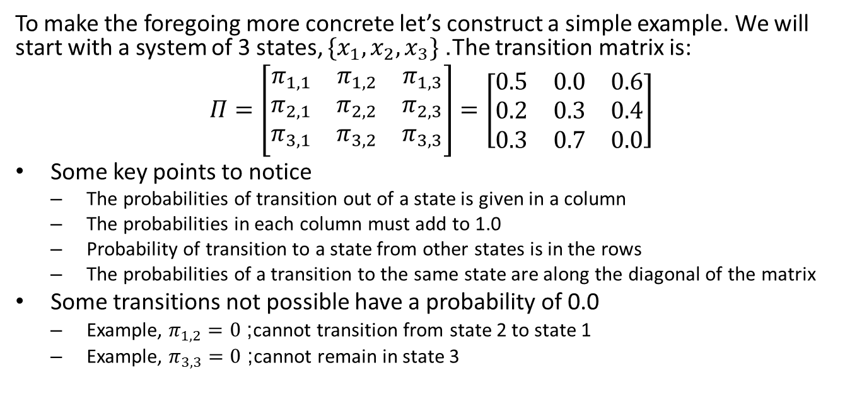
Example of a Markov Process
To make the foregoing more concrete let’s construct a simple example. We will start with a system of 3 states, $\{x_{1},x_{2},x_{3}\}$. The transition matrix is:
$$Π=\left[\begin{matrix}π_{1,1} & π_{1,2} & π_{1,3} \\ π_{2,1} & π_{2,2} & π_{2,3} \\ π_{3,1} & π_{3,2} & π_{3,3}\end{matrix}\right]=\left[\begin{matrix}0.5 & 0.0 & 0.6 \\ 0.2 & 0.3 & 0.4 \\ 0.3 & 0.7 & 0.0\end{matrix}\right]$$
Some key points to notice
The probabilities of transition out of a state is given in a column
The probabilities in each column must add to 1.0
Probability of transition to a state from other states is in the rows
The probabilities of a transition to the same state are along the diagonal of the matrix
Some transitions not possible have a probability of 0.0
Example, $π_{1,2}=0$; cannot transition from state 2 to state 1
Example, $π_{3,3}=0$; cannot remain in state 3

Slide 11
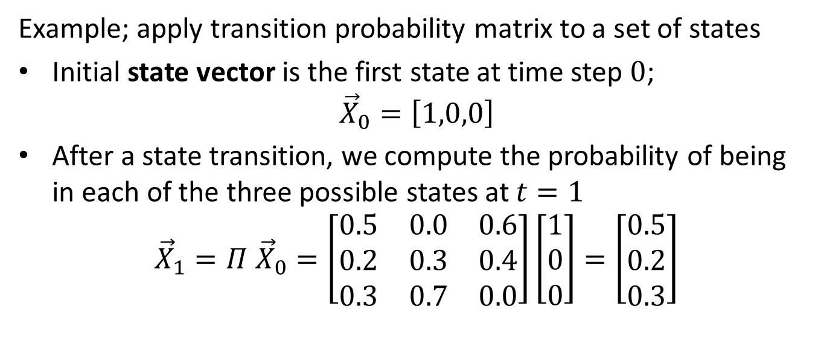
Example of a Markov Process
Example; apply transition probability matrix to a set of states
Initial state vector is the first state at time step $0$;
$${\vec{X}}_{0}=\left[1,0,0\right]$$
After a state transition, we compute the probability of being in each of the three possible states at $t=1$
$${\vec{X}}_{1}=Π {\vec{X}}_{0}=\left[\begin{matrix}0.5 & 0.0 & 0.6 \\ 0.2 & 0.3 & 0.4 \\ 0.3 & 0.7 & 0.0\end{matrix}\right]\left[\begin{matrix}1 \\ 0 \\ 0\end{matrix}\right]=\left[\begin{matrix}0.5 \\ 0.2 \\ 0.3\end{matrix}\right]$$

Slide 12
Markov Chains

Slide 13
From Markov process to Markov chain
What happens when there is a series of Markov transitions?
A sequence of such transitions is known as a Markov chain
There are two classes of Markov Chains
Episodic Markov chains have a terminal state
The terminal state can only transition to itself
Once the system is in the terminal state, we say that the episode has ended
Episodic processes are not of interest here
Continuous Markov chains have no terminal state
Continue indefinitely, at least in principle
Continuous Markov chains sample probability distributions
Are ideal for estimating Bayesian posterior distributions

Slide 14
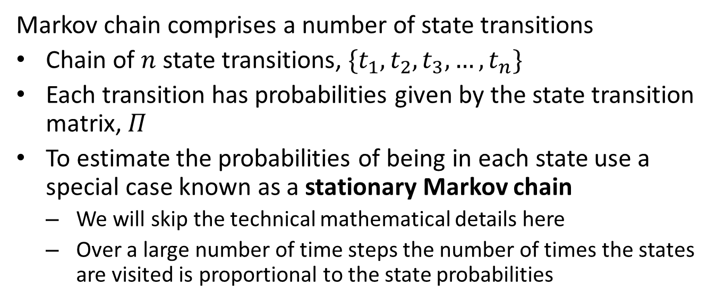
From Markov process to Markov chain
Markov chain comprises a number of state transitions
Chain of $n$ state transitions, $\{t_{1},t_{2},t_{3},…,t_{n}\}$
Each transition has probabilities given by the state transition matrix, $Π$
To estimate the probabilities of being in each state use a special case known as a stationary Markov chain
We will skip the technical mathematical details here
Over a large number of time steps the number of times the states are visited is proportional to the state probabilities

Slide 15
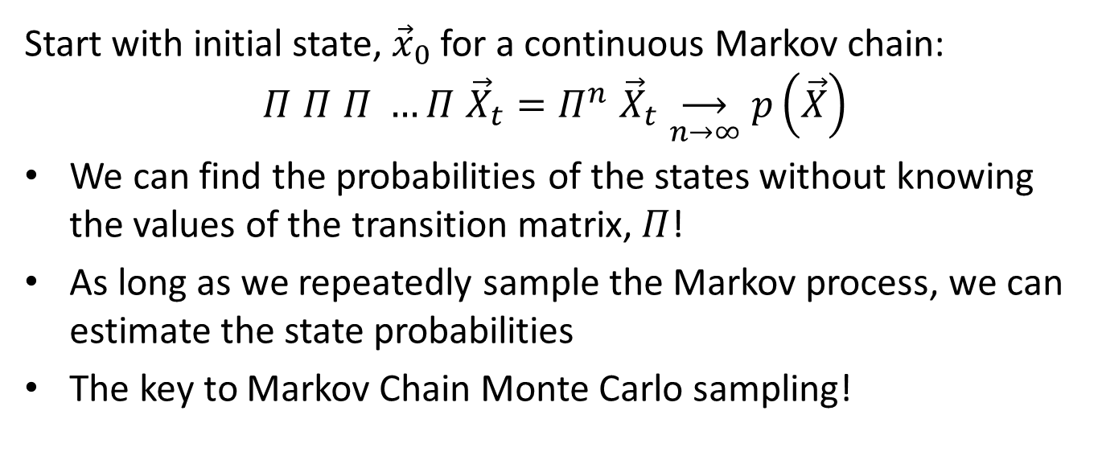
From Markov process to Markov chain
Start with initial state, ${\vec{x}}_{0}$ for a continuous Markov chain:
$$Π Π Π …Π {\vec{X}}_{t}=Π^{n} {\vec{X}}_{t}\underset{n→∞}{⟶}p\left(\vec{X}\right)$$
We can find the probabilities of the states without knowing the values of the transition matrix, $Π$!
As long as we repeatedly sample the Markov process, we can estimate the state probabilities
The key to Markov Chain Monte Carlo sampling!

Slide 16
Metropolis-Hastings Sampling

Slide 17
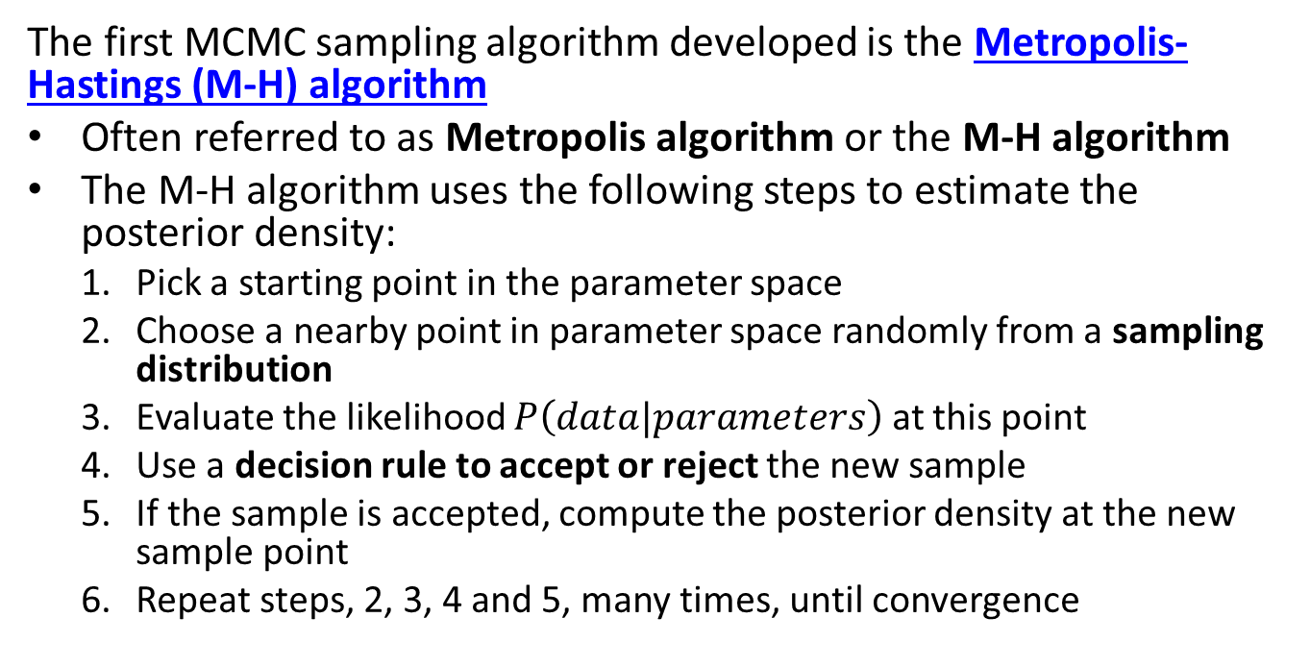
MCMC and the Metropolis-Hastings Algorithm
The first MCMC sampling algorithm developed is the Metropolis-Hastings (M-H) algorithm
Often referred to as Metropolis algorithm or the M-H algorithm
The M-H algorithm uses the following steps to estimate the posterior density:
Pick a starting point in the parameter space
Choose a nearby point in parameter space randomly from a sampling distribution
Evaluate the likelihood $P\left(data|parameters\right)$ at this point
Use a decision rule to accept or reject the new sample
If the sample is accepted, compute the posterior density at the new sample point
Repeat steps, 2, 3, 4 and 5, many times, until convergence

Slide 18
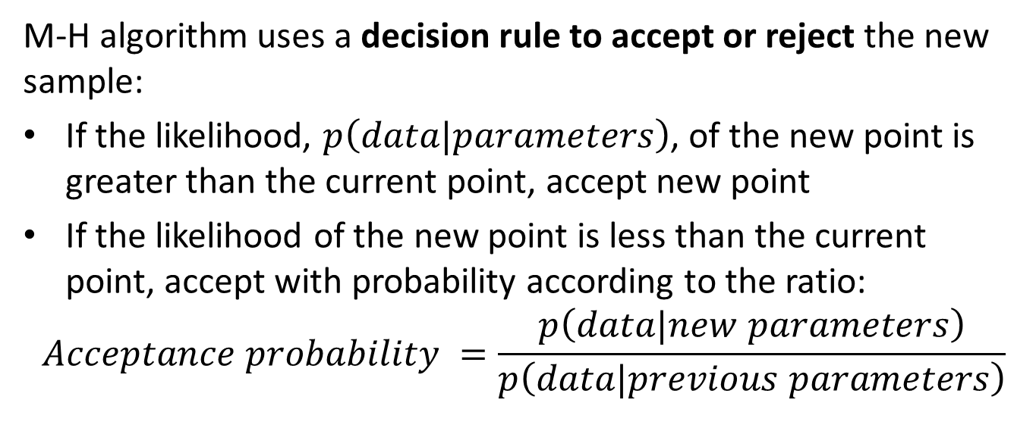
MCMC and the Metropolis-Hastings Algorithm
M-H algorithm uses a decision rule to accept or reject the new sample:
If the likelihood, $p\left(data|parameters\right)$, of the new point is greater than the current point, accept new point
If the likelihood of the new point is less than the current point, accept with probability according to the ratio:
$$Acceptance probability =\frac{p\left(data|new parameters\right)}{p\left(data|previous parameters\right)}$$

Slide 19
MCMC and the Metropolis-Hastings Algorithm
Eventually, the M-H algorithms converges to the posterior distribution
M-H random sampling algorithm is far more sample efficient than naive grid sampling
Consider how M-H algorithm probabilistically samples the parameter space
Preferentially sample high density areas
Not every point on a grid
Important properties of the Metropolis-Hastings MCMC algorithm include:
The M-H algorithm is guaranteed to eventually converge to the underlying distribution
High serial correlation from one sample to the next in chain gives slow convergence

Slide 20
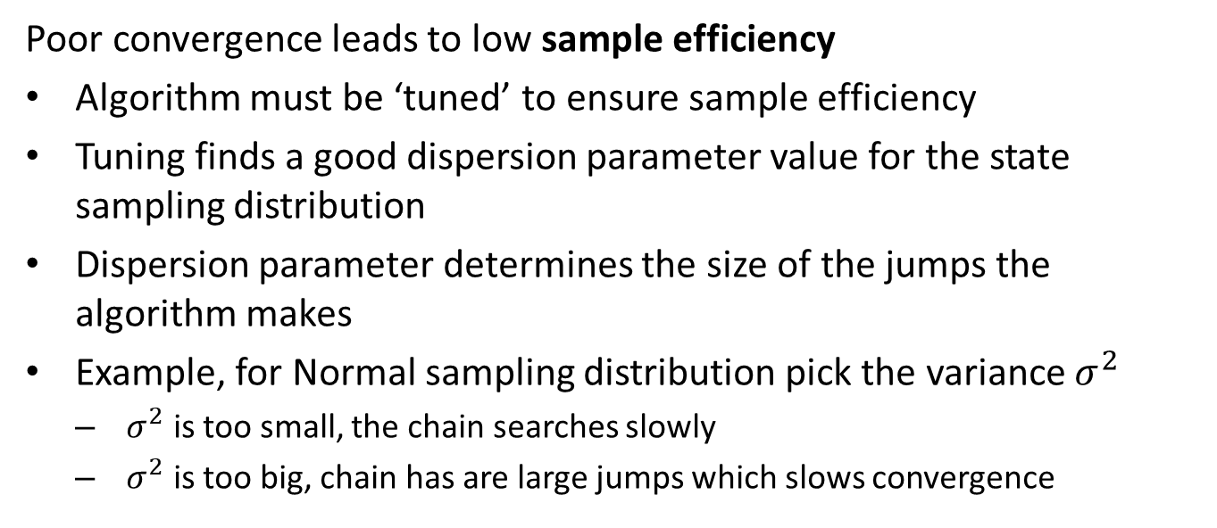
MCMC and the Metropolis-Hastings Algorithm
Poor convergence leads to low sample efficiency
Algorithm must be ‘tuned’ to ensure sample efficiency
Tuning finds a good dispersion parameter value for the state sampling distribution
Dispersion parameter determines the size of the jumps the algorithm makes
Example, for Normal sampling distribution pick the variance $σ^{2}$
$σ^{2}$ is too small, the chain searches slowly
$σ^{2}$ is too big, chain has are large jumps which slows convergence

Slide 21
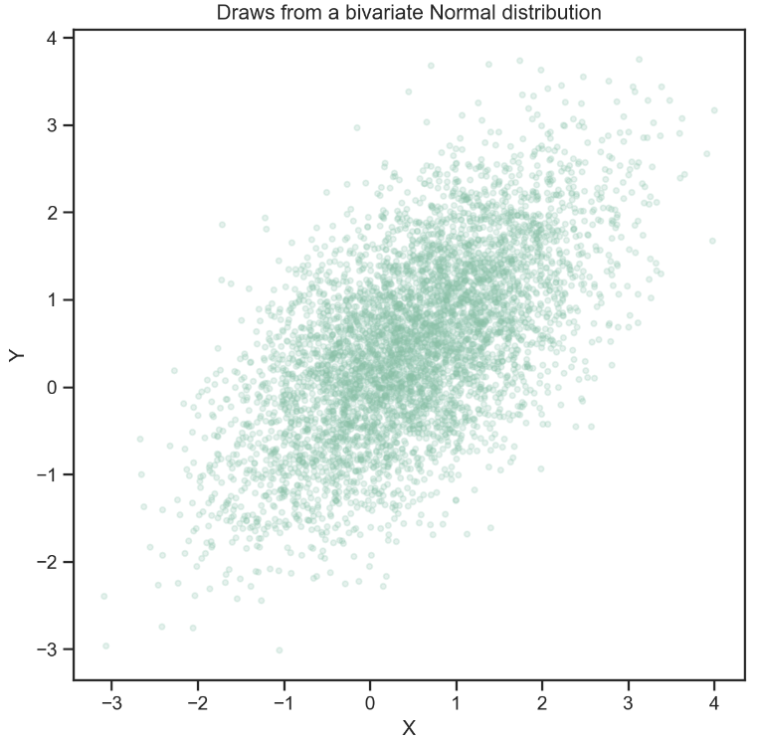
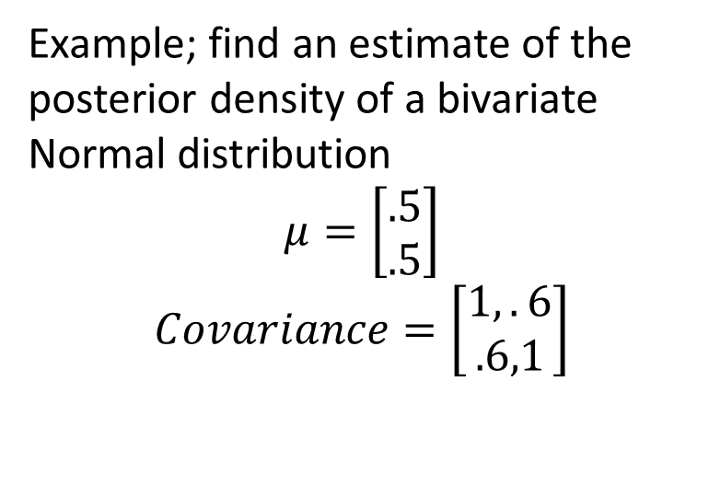
M-H algorithm example
Example; find an estimate of the posterior density of a bivariate Normal distribution
$$μ=\left[\begin{matrix}.5 \\ .5\end{matrix}\right]$$
$$Covariance=\left[\begin{matrix}1,.6 \\ .6,1\end{matrix}\right]$$
Random samples from a bivariate Normal distribution

Slide 22
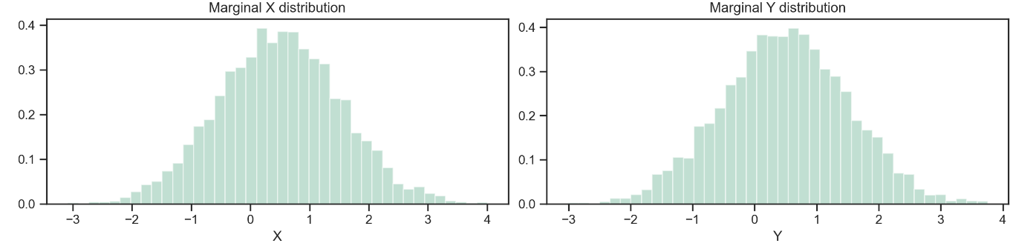
M-H algorithm example
And, the marginal distributions of the variables
Marginal distributions of bivariate Normal samples

Slide 23
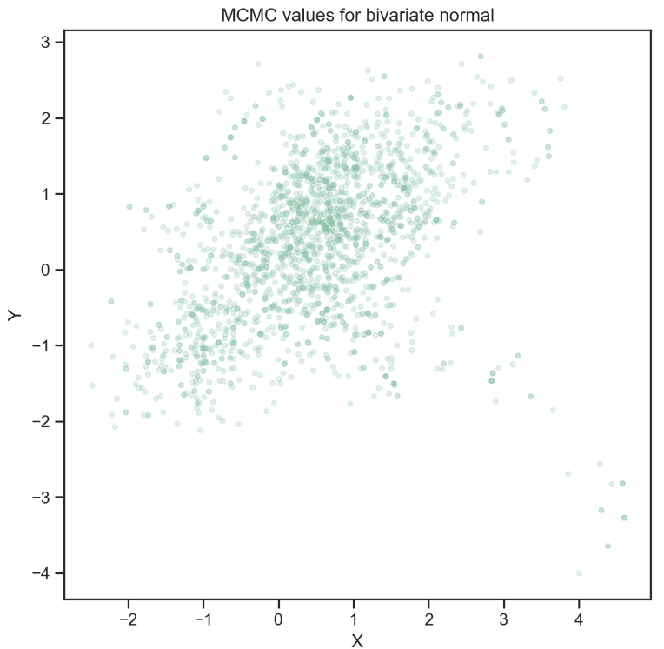
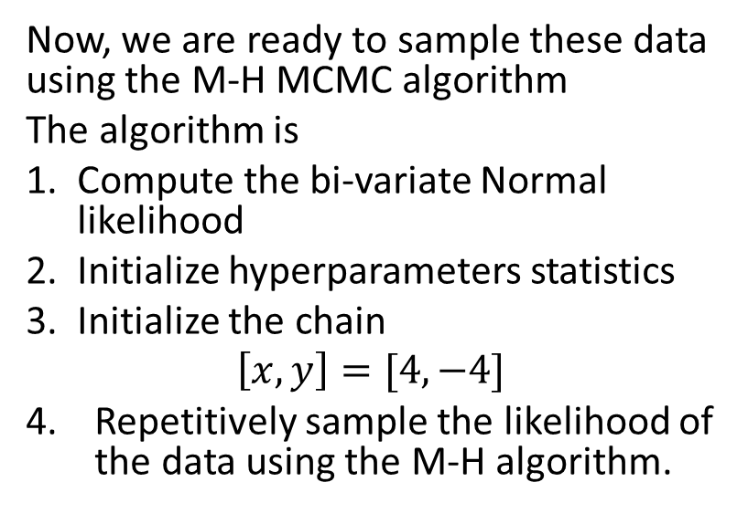
M-H algorithm example
Now, we are ready to sample these data using the M-H MCMC algorithm
The algorithm is
Compute the bi-variate Normal likelihood
Initialize hyperparameters statistics
Initialize the chain
$$\left[x,y\right]=[4,−4]$$
Repetitively sample the likelihood of the data using the M-H algorithm.
MCMC samples from bivariate Normal distribution

Slide 24
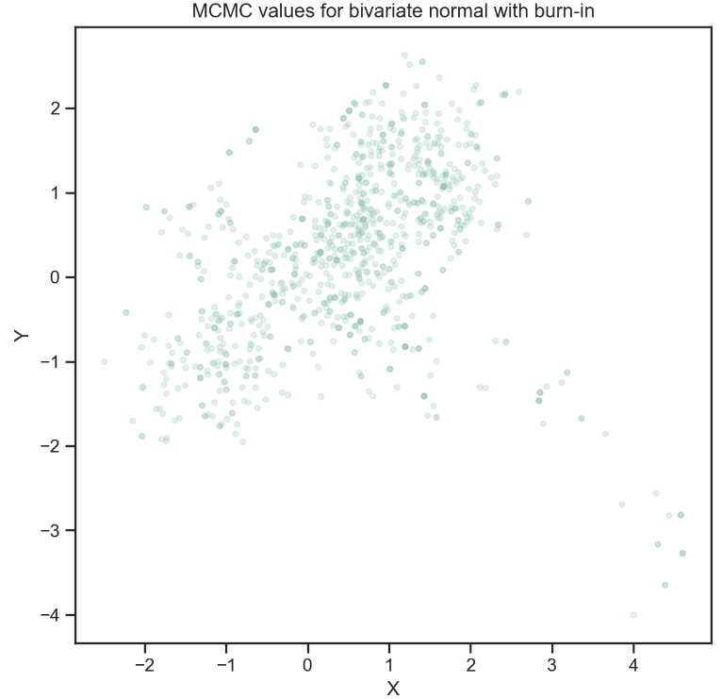
M-H algorithm example
A plot the first 500 samples from the M-H algorithm
Density of M-H sample begins to resemble the distribution
Notice the long ‘tail’ on the samples during the burn-in period.
MCMC samples from bivariate Normal distribution

Slide 25
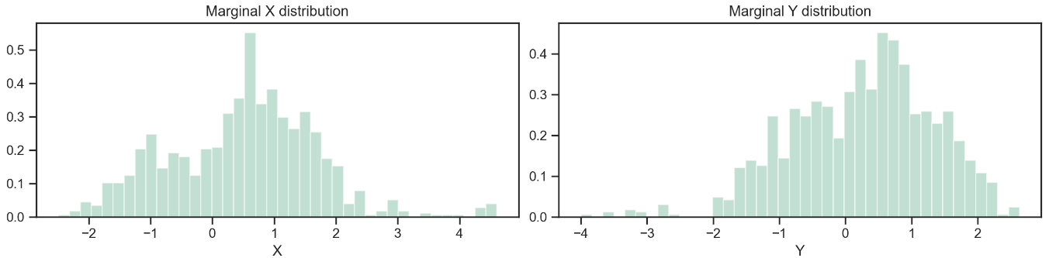
M-H algorithm example
Marginal distributions of the MCMC samples, less first 500
These marginals are similar to the original distribution but with the ‘tail’ from the burn-in period
First 500 MCMC samples from bivariate Normal distribution

Slide 26
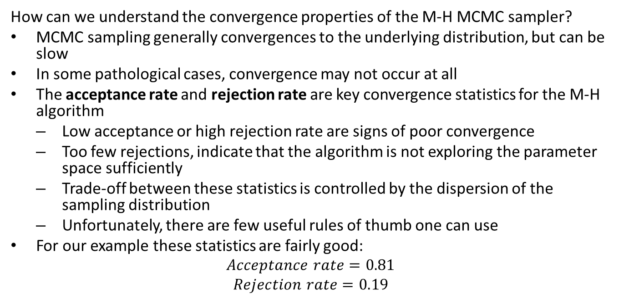
Convergence and sampling efficiency of MCMC
How can we understand the convergence properties of the M-H MCMC sampler?
MCMC sampling generally convergences to the underlying distribution, but can be slow
In some pathological cases, convergence may not occur at all
The acceptance rate and rejection rate are key convergence statistics for the M-H algorithm
Low acceptance or high rejection rate are signs of poor convergence
Too few rejections, indicate that the algorithm is not exploring the parameter space sufficiently
Trade-off between these statistics is controlled by the dispersion of the sampling distribution
Unfortunately, there are few useful rules of thumb one can use
For our example these statistics are fairly good:
$$Acceptance rate=0.81$$
$$Rejection rate=0.19$$

Slide 27
Evaluation of MCMC Sampling

Slide 28
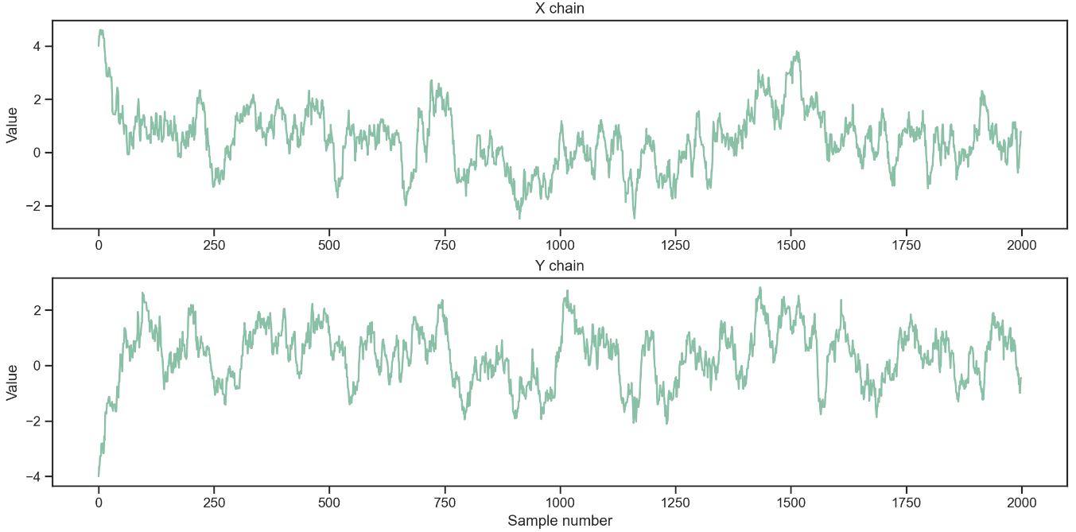
Evaluation of MCMC sampling
Trace plot of the samples displays the sample value of the parameter with sample number
The traces show sampling around the highest density values of the parameters, indicating good convergence
Trace plots for two variables from the M-H algorithm

Slide 29
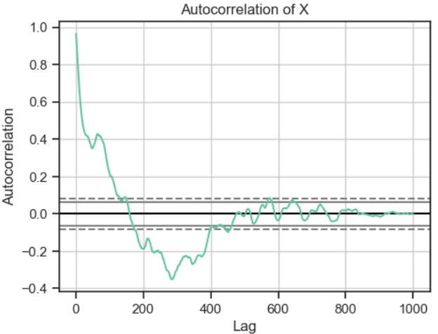
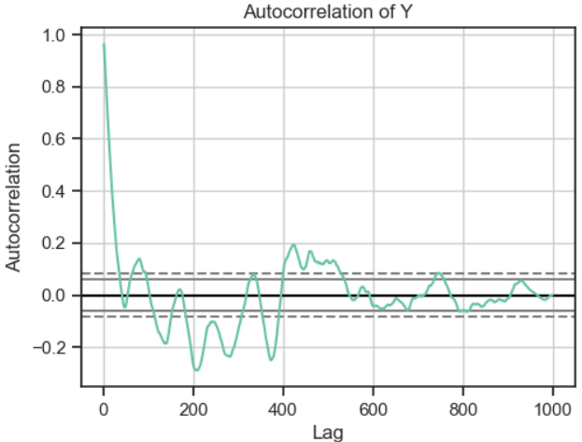
Evaluation of MCMC sampling
An autocorrelation plot shows how a sample value is related to the previous samples
Notice that the autocorrelation dies off fairly quickly with lag
The autocorrelation of the Markov chain shows the dependency of the samples
Low autocorrelation indicates good sampling efficiency
High autocorrelation indicates poor sampling efficiency
Autocorrelation of Markov chain for the two parameters

Slide 30
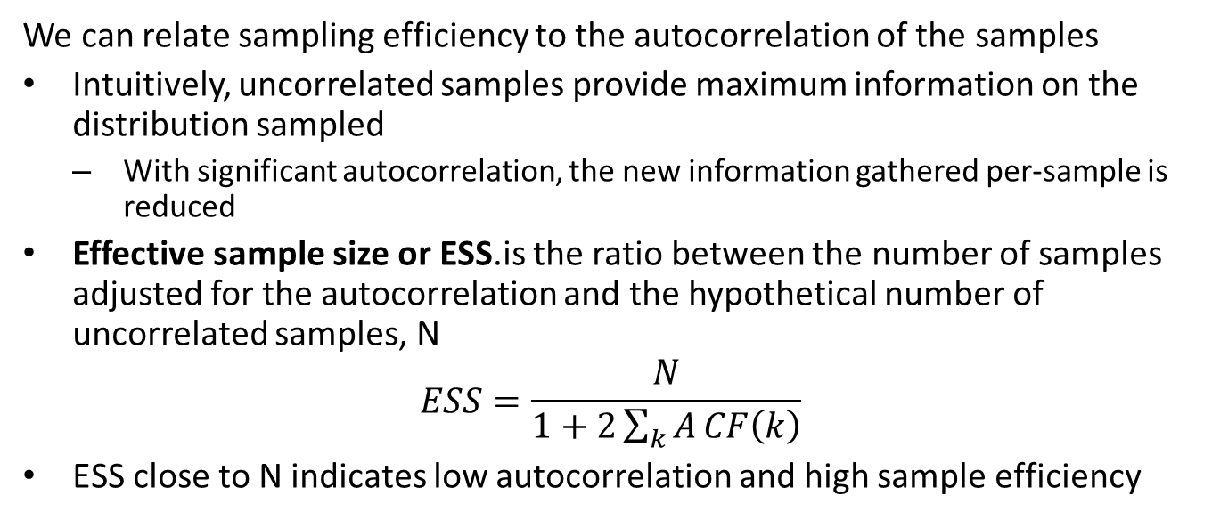
Evaluation of MCMC sampling
We can relate sampling efficiency to the autocorrelation of the samples
Intuitively, uncorrelated samples provide maximum information on the distribution sampled
With significant autocorrelation, the new information gathered per-sample is reduced
Effective sample size or ESS.is the ratio between the number of samples adjusted for the autocorrelation and the hypothetical number of uncorrelated samples, N
$$ESS=\frac{N}{1+2\sum_{k}^{​}{A}CF\left(k\right)}$$
ESS close to N indicates low autocorrelation and high sample efficiency

Slide 31
Gibbs Sampling

Slide 32
Other MCMC Sampling Algorithms
Why do we need other sampling algorithms when we have M-H?
M-H algorithm uses a random walk with an acceptance criteria to integrate over density
The M-H algorithm has a tendency to wander and over-sample low density regions
Most samples are in the high density region if algorithm properly tuned
MCMC samples from bivariate Normal distribution

Slide 33
Other MCMC Sampling Algorithms
A number of other powerful MCMC sampling algorithms have been developed
The M-H can suffer from slow convergence for several reasons
Random walk nature of the M-H leads to time spent sampling low density regions of posterior
Generally M-H samples have fairly high serial correlation and low ESS
Must ‘tune’ the acceptance probability distribution
As a result of these limitations, other MCMC sampling methods have been proposed in a quest to improve sample efficiency including:
Gibbs sampling
No U-turn sampling (NUTS)

Slide 34
Gibbs sampling
Gibbs sampler is an improved MCMC sampler which speeds convergence
Named for the 19th Century physicist Josiah Willard Gibbs; inspired by statistical mechanics
Gibbs sampler round-robin samples each dimension of the parameter space
Update along each dimension approximately orthogonal to the preceding sampled dimension
M-H algorithm attempts jumps across all dimensions of the parameter space
Compared to M-H, Gibbs sampling reduces serial correlation through round-robin sampling
There are no tuning parameters since sampling is based on the marginals of the likelihood.

Slide 35
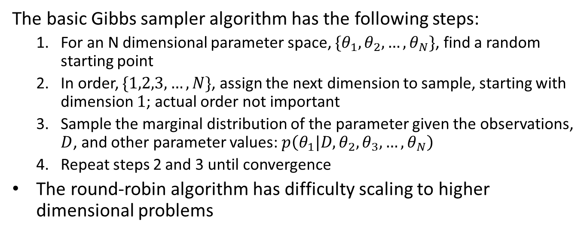
Gibbs sampling
The basic Gibbs sampler algorithm has the following steps:
For an N dimensional parameter space, $\{θ_{1},θ_{2},…,θ_{N}\}$, find a random starting point
In order, $\{1,2,3,…,N\}$, assign the next dimension to sample, starting with dimension $1$; actual order not important
Sample the marginal distribution of the parameter given the observations, $D$, and other parameter values: $p\left(θ_{1}|D,θ_{2},θ_{3},…,θ_{N}\right)$
Repeat steps 2 and 3 until convergence
The round-robin algorithm has difficulty scaling to higher dimensional problems

Slide 36
Hamiltonian Sampling and the NUTS Algorithm

Slide 37
Hamiltonian MCMC
The Hamiltonian sampler was proposed in 1987 (Duane, et.al.) and uses a simple idea from classical mechanics
Attempt to improve convergence of Metropolis-Hastings algorithm
Hamiltonian MCMC attempts to create a better sampling path
Uses an analogy with classical physics
Constrains the search to favor high-density parts of the posterior distribution
Imagine that the posterior density is like a hilly landscape
We want to sample around the high spots, the maximum density points
We call density potential
Imagin, we roll a ball around the landscape to the highest potential energy points
Ball has potential energy and kinetic energy with the total energy conserved
Want sampling trajectory to favor high potential energy regions

Slide 38
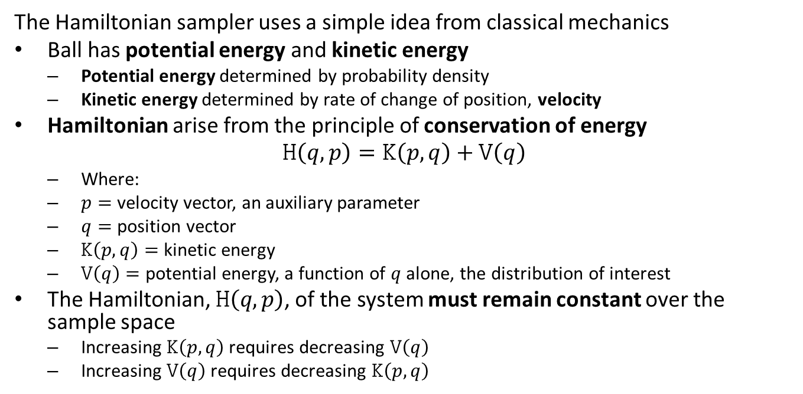
Hamiltonian MCMC
The Hamiltonian sampler uses a simple idea from classical mechanics
Ball has potential energy and kinetic energy
Potential energy determined by probability density
Kinetic energy determined by rate of change of position, velocity
Hamiltonian arise from the principle of conservation of energy
$$H\left(q,p\right)=K\left(p,q\right)+V\left(q\right)$$
Where:
$p=$ velocity vector, an auxiliary parameter
$q=$ position vector
$K\left(p,q\right)=$ kinetic energy
$V\left(q\right)=$ potential energy, a function of $q$ alone, the distribution of interest
The Hamiltonian, $H\left(q,p\right)$, of the system must remain constant over the sample space
Increasing $K\left(p,q\right)$ requires decreasing $V\left(q\right)$
Increasing $V\left(q\right)$ requires decreasing $K\left(p,q\right)$

Slide 39
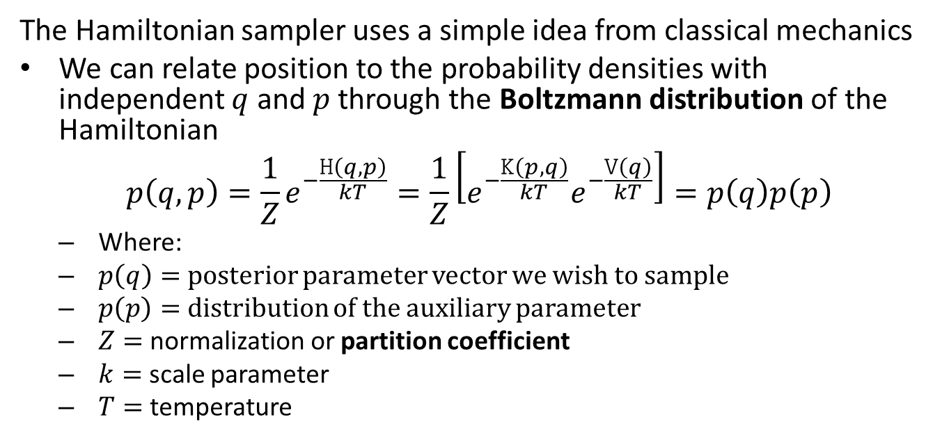
Hamiltonian MCMC
The Hamiltonian sampler uses a simple idea from classical mechanics
We can relate position to the probability densities with independent $q$ and $p$ through the Boltzmann distribution of the Hamiltonian
$$p\left(q,p\right)=\frac{1}{Z}e^{−\frac{H\left(q,p\right)}{kT}}=\frac{1}{Z}\left[e^{−\frac{K\left(p,q\right)}{kT}}e^{−\frac{V\left(q\right)}{kT}}\right]=p\left(q\right)p\left(p\right)$$
Where:
$p\left(q\right)=$ posterior parameter vector we wish to sample
$p\left(p\right)=$ distribution of the auxiliary parameter
$Z=$ normalization or partition coefficient
$k=$ scale parameter
$T=$ temperature

Slide 40
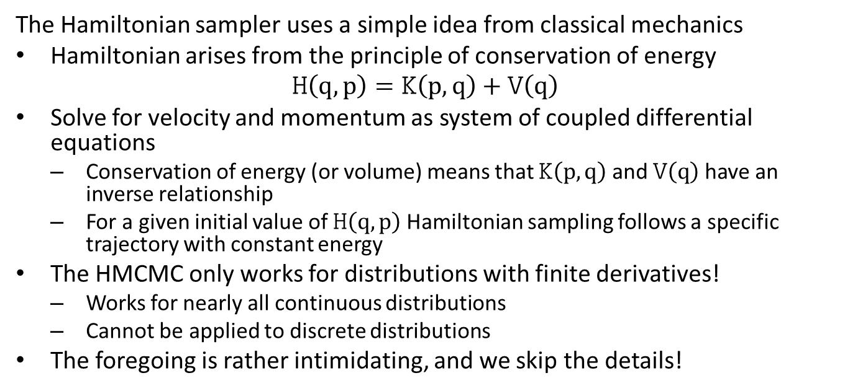
Hamiltonian MCMC
The Hamiltonian sampler uses a simple idea from classical mechanics
Hamiltonian arises from the principle of conservation of energy
$$H\left(q,p\right)=K\left(p,q\right)+V\left(q\right)$$
Solve for velocity and momentum as system of coupled differential equations
Conservation of energy (or volume) means that $K\left(p,q\right)$ and $V\left(q\right)$ have an inverse relationship
For a given initial value of $H\left(q,p\right)$ Hamiltonian sampling follows a specific trajectory with constant energy
The HMCMC only works for distributions with finite derivatives!
Works for nearly all continuous distributions
Cannot be applied to discrete distributions
The foregoing is rather intimidating, and we skip the details!

Slide 41
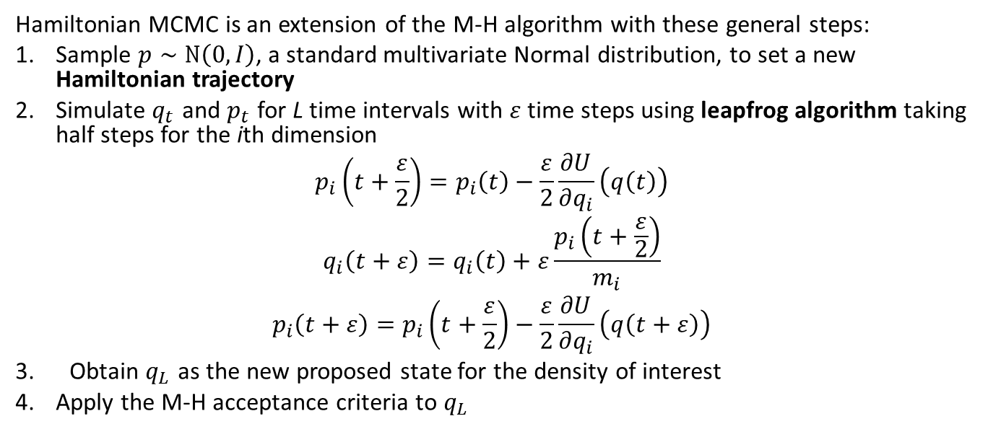
Hamiltonian MCMC
Hamiltonian MCMC is an extension of the M-H algorithm with these general steps:
Sample $p∼N\left(0,I\right)$, a standard multivariate Normal distribution, to set a new Hamiltonian trajectory
Simulate $q_{t}$ and $p_{t}$ for L time intervals with $ε$ time steps using leapfrog algorithm taking half steps for the ith dimension
$$p_{i}\left(t+\frac{ε}{2}\right)=p_{i}\left(t\right)−\frac{ε}{2}\frac{∂U}{∂q_{i}}\left(q\left(t\right)\right)$$
$$q_{i}\left(t+ε\right)=q_{i}\left(t\right)+ε\frac{p_{i}\left(t+\frac{ε}{2}\right)}{m_{i}}$$
$$p_{i}\left(t+ε\right)=p_{i}\left(t+\frac{ε}{2}\right)−\frac{ε}{2}\frac{∂U}{∂q_{i}}\left(q\left(t+ε\right)\right)$$
Obtain $q_{L}$ as the new proposed state for the density of interest
Apply the M-H acceptance criteria to $q_{L}$

Slide 42
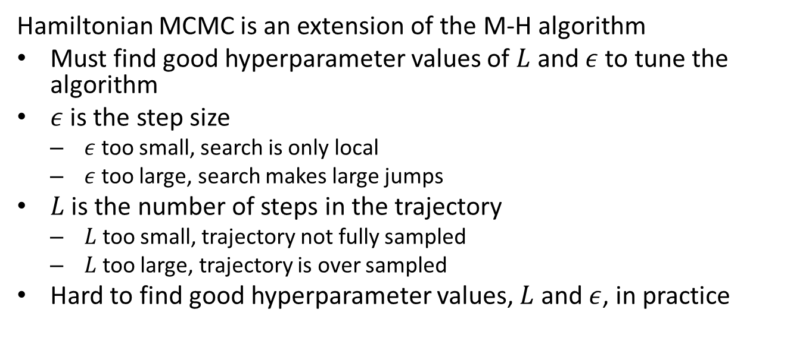
Hamiltonian MCMC
Hamiltonian MCMC is an extension of the M-H algorithm
Must find good hyperparameter values of $L$ and $ε$ to tune the algorithm
$ε$ is the step size
$ε$ too small, search is only local
$ε$ too large, search makes large jumps
$L$ is the number of steps in the trajectory
$L$ too small, trajectory not fully sampled
$L$ too large, trajectory is over sampled
Hard to find good hyperparameter values, $L$ and $ε$, in practice

Slide 43
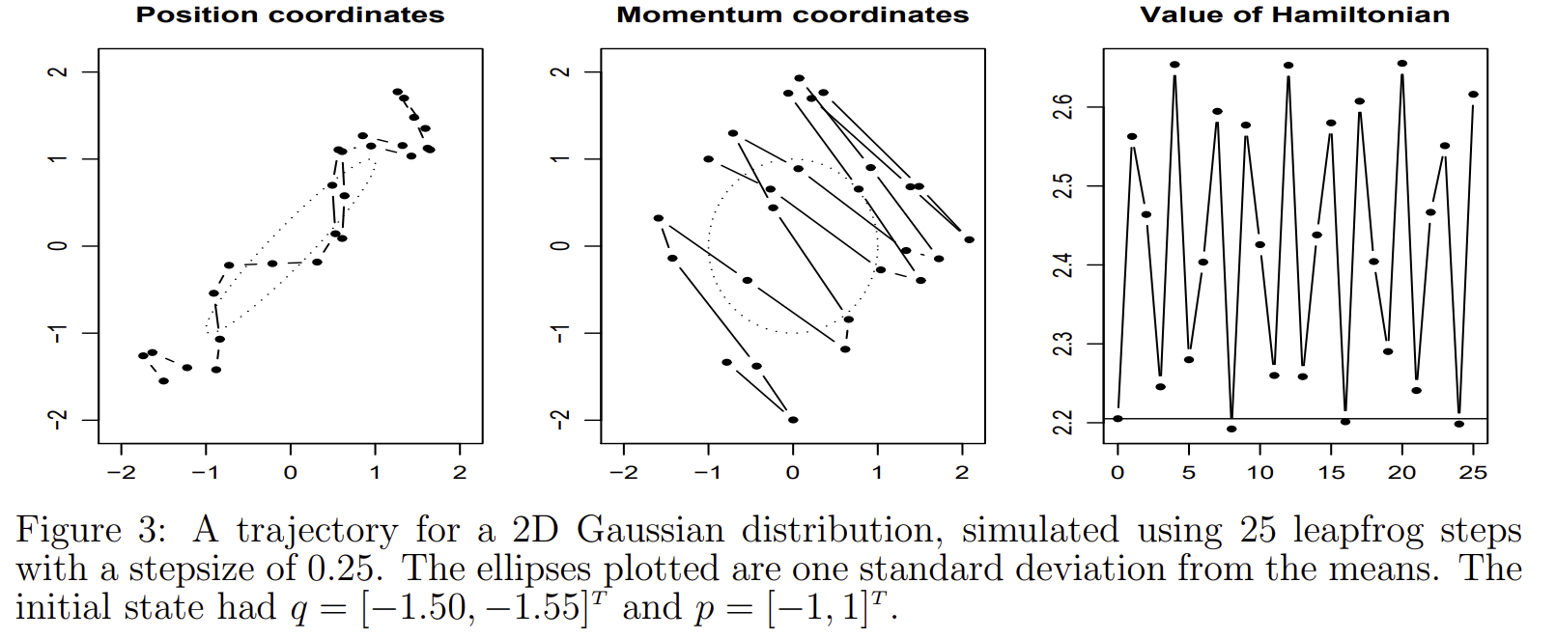
No U-Turn Sampler
NUTS represents the state of the art in MCMC samplers: Hoffman and Gelman 2014
Selection of number of Hamiltonian leapfrog steps, L, is a difficult tuning problem
If L too small, trajectory is not fully sampled
If L too large, trajectory makes a U-turn making redundant samples
Figure from Hamiltonian Monte Carlo Explained, Alex Rogozhnikov, 2016

Slide 44
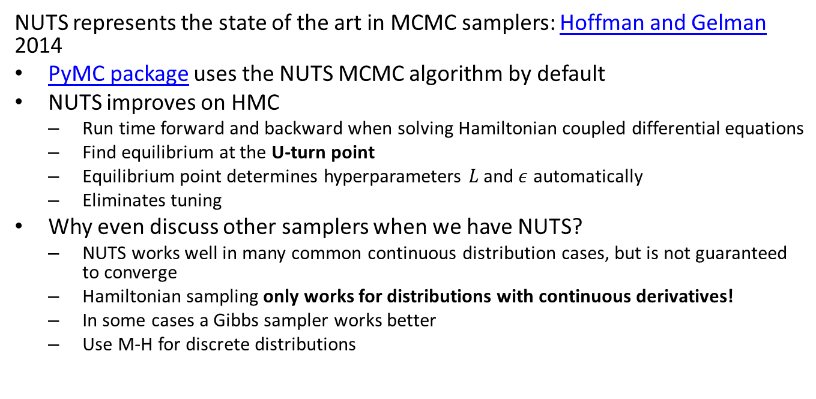
No U-Turn Sampler
NUTS represents the state of the art in MCMC samplers: Hoffman and Gelman 2014
PyMC package uses the NUTS MCMC algorithm by default
NUTS improves on HMC
Run time forward and backward when solving Hamiltonian coupled differential equations
Find equilibrium at the U-turn point
Equilibrium point determines hyperparameters $L$ and $ε$ automatically
Eliminates tuning
Why even discuss other samplers when we have NUTS?
NUTS works well in many common continuous distribution cases, but is not guaranteed to converge
Hamiltonian sampling only works for distributions with continuous derivatives!
In some cases a Gibbs sampler works better
Use M-H for discrete distributions

Slide 45
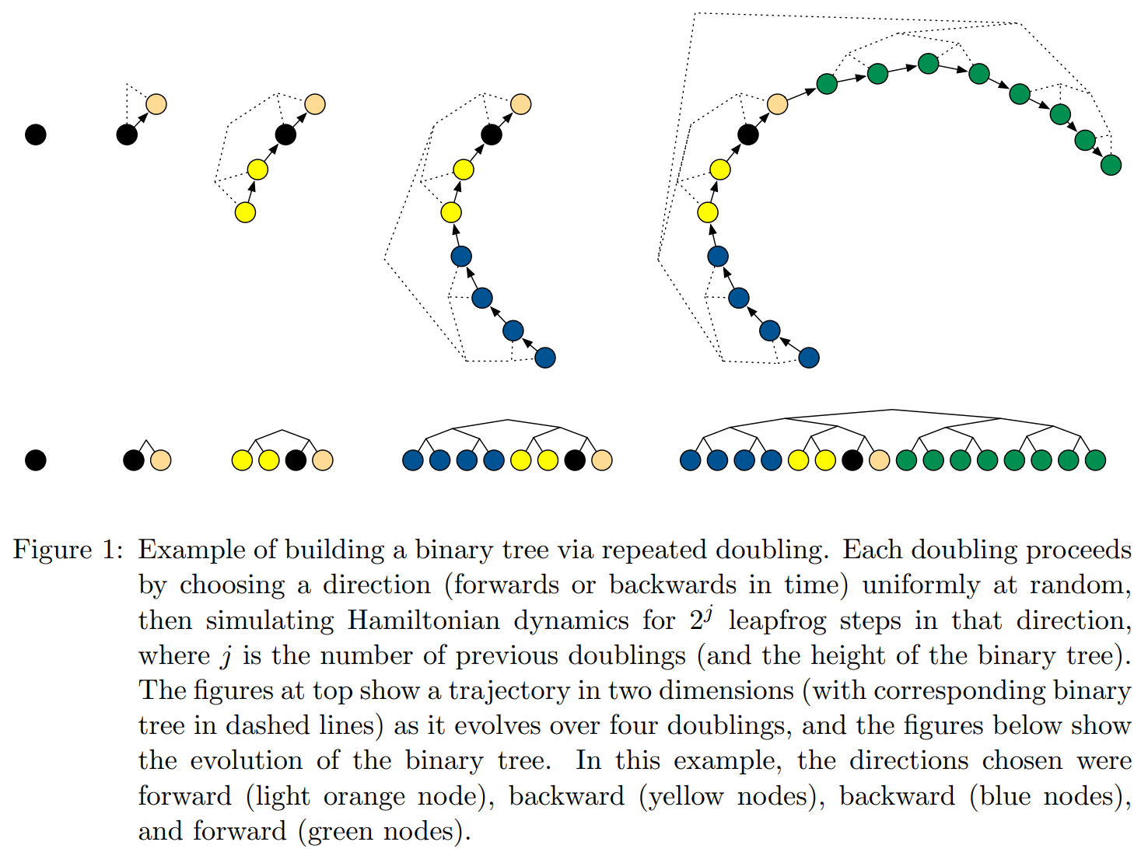
No U-Turn Sampler
NUTS algorithm maintains a binary tree of samples
Sample randomly drawn trajectory
Double the number of samples on right and then left
Doubling stops when Hamiltonian equilibrium point reached
Trajectory has no U-turns!
Figure from Hoffman and Gelman 2014

Slide 46
Hamiltonian MCMC
Hamiltonian MCMC and NUTS are complex algorithms - some resources for learning the details
A Conceptual Introduction to Hamiltonian Monte Carlo, Michael Betancourt, 2017
MCMC Using Hamiltonian Dynamics, Radford Niel, 2012
Hamiltonian Monte Carlo Explained, Alex Rogozhnikov, 2016
The No-U-Turn Sampler: Adaptively Setting Path Lengths in Hamiltonian Monte Carlo, Hofman and Gelman, 2014

Slide 47
MCMC Bayes Example

Slide 48
Key Steps for MCMC Bayes Modeling
Steps of modern Bayes modeling and evaluation
Define the problem
Collect the dataset
Define a model, including priors
Prior predictive checks - are the priors reasonable for the problem?
MCMC sample the model
Verify MCMC sampling convergence and sufficiency
Posterior predictive checks - Do the posterior predictions agree with the observed response?
Update the model with additional data as required
The ArviZ package is dedicated to evaluation of Bayes MCMC models.
Multiple examples of diagnostics for the breakdown of MCMC sampling can be found in an online Appendix to a seminal paper Vehtari et.al., 2019

Slide 49
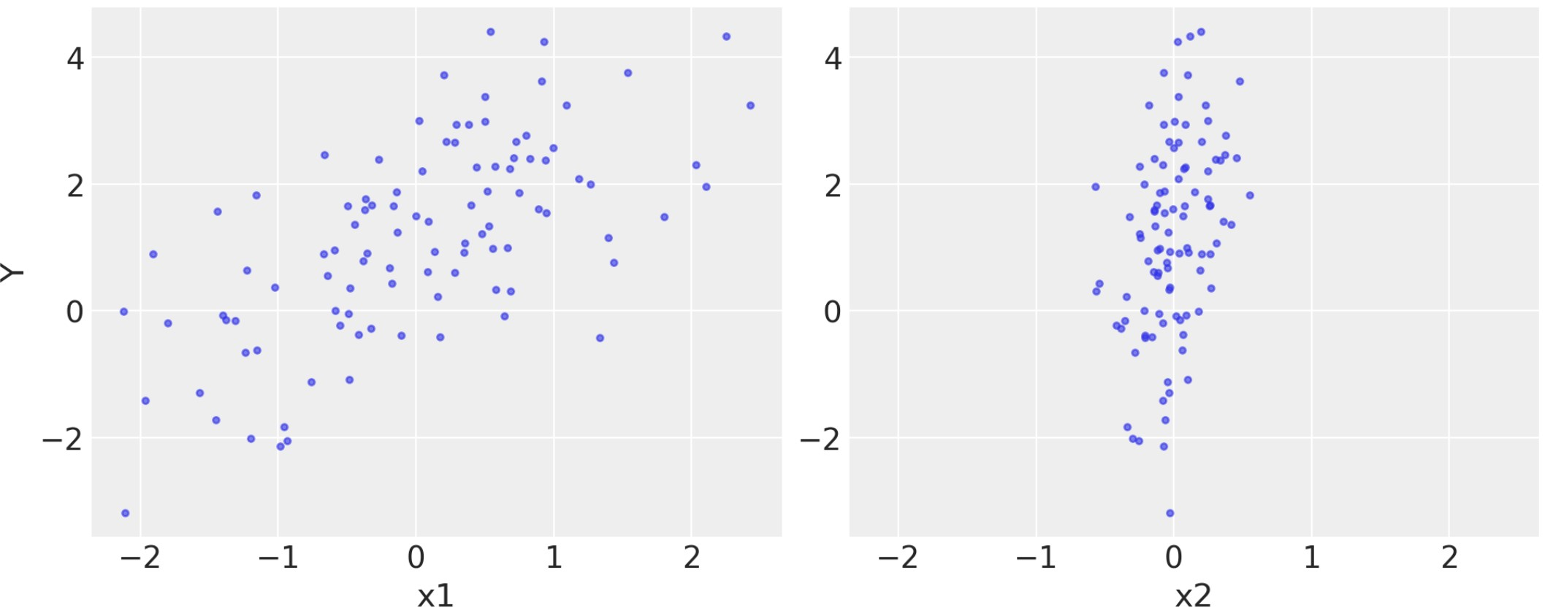
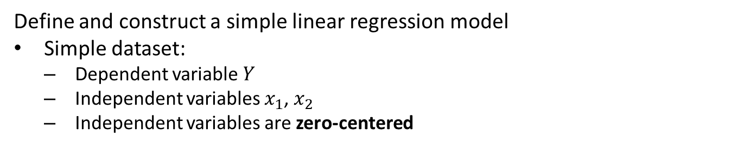
Constructing an MCMC Model with PyMC
Define and construct a simple linear regression model
Simple dataset:
Dependent variable $Y$
Independent variables $x_{1}$, $x_{2}$
Independent variables are zero-centered
Data for regression example

Slide 50
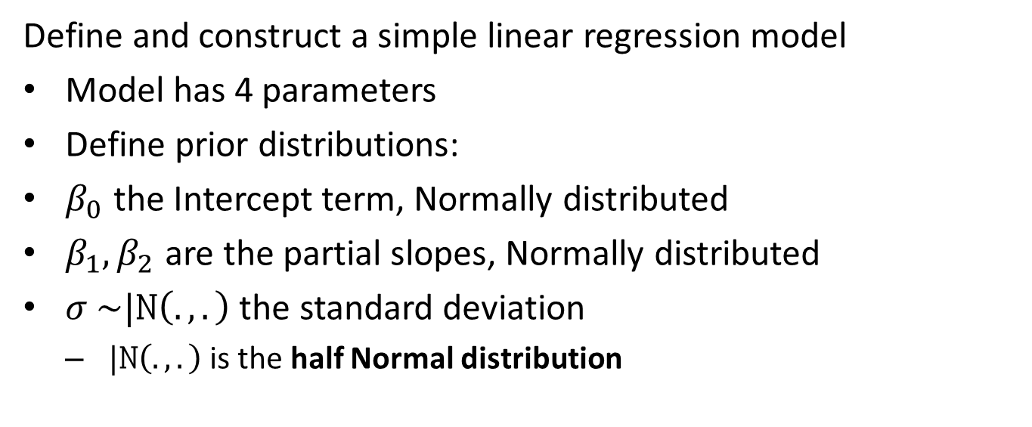
Constructing an MCMC Model with PyMC
Define and construct a simple linear regression model
Model has 4 parameters
Define prior distributions:
$β_{0}$ the Intercept term, Normally distributed
$β_{1},β_{2}$ are the partial slopes, Normally distributed
$σ$ $\sim |N\left(.,.\right)$ the standard deviation
$|N\left(.,.\right)$is the half Normal distribution

Slide 51
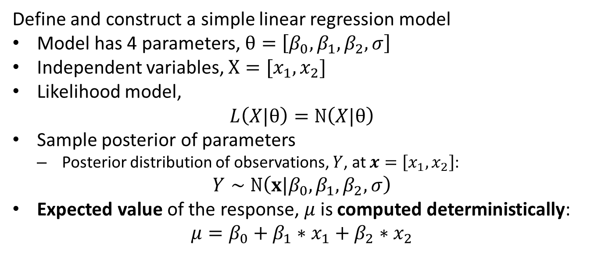
Constructing an MCMC Model with PyMC
Define and construct a simple linear regression model
Model has 4 parameters, $θ=\left[β_{0},β_{1},β_{2},σ\right]$
Independent variables, $X=[x_{1},x_{2}]$
Likelihood model,
$$L\left(X|θ\right)=N\left(X|θ\right)$$
Sample posterior of parameters
Posterior distribution of observations, $Y$, at $x=\left[x_{1},x_{2}\right]$:
$$Y∼N\left({x|β}_{0},β_{1},β_{2},σ\right)$$
Expected value of the response, $μ$ is computed deterministically:
$$μ=β_{0}+β_{1}∗x_{1}+β_{2}∗x_{2}$$

Slide 52
Constructing an MCMC Model with PyMC
Define and construct a simple linear regression model using Python PyMC package to construct the model
with pymc.Model() as regression_model: # Priors for unknown model parameters betas = pymc.Normal("betas", mu=0, sigma=2, shape=3) sigma = pymc.HalfNormal("sigma", sigma=1) # Deterministic expected value of outcome mu = betas[0] + betas[1] * x1 + betas[2] * x2 # Likelihood (sampling distribution) of observations Y_obs = pymc.Normal("Y_obs", mu=mu, sigma=sigma, observed=Y)

Slide 53
Prior Predictive Checks

Slide 54
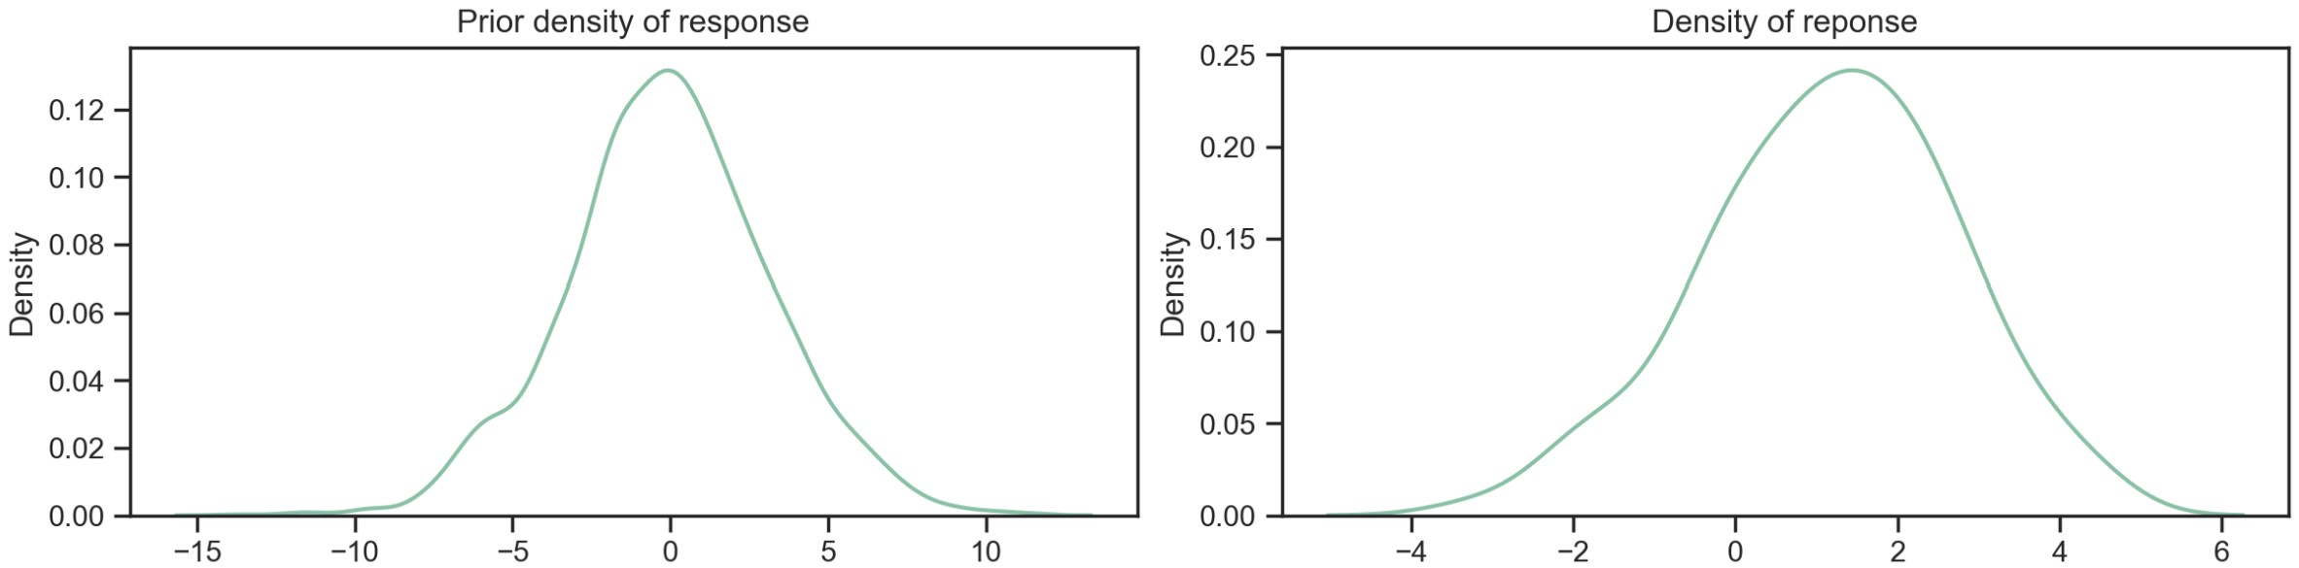
Prior Predictive Checks
Prior predictive checks to verify prior distribution choice
Prior predictive checks verify that choices of prior distributions are at least reasonable
Compare the distribution of the response variable with the posterior distribution generated by priors.
Is the posterior distribution in the absence of evidence (data)
Prior predictive response vs response variable distribution

Slide 55
Prior Predictive Checks
Prior predictive checks to verify prior distribution choice
Distribution shape is similar
No noticeable anomalies
Higher dispersion of prior check distribution is desired
No evidence is used to narrow distribution
Do not want to restrict the solution
Prior predictive response vs response variable distribution

Slide 56
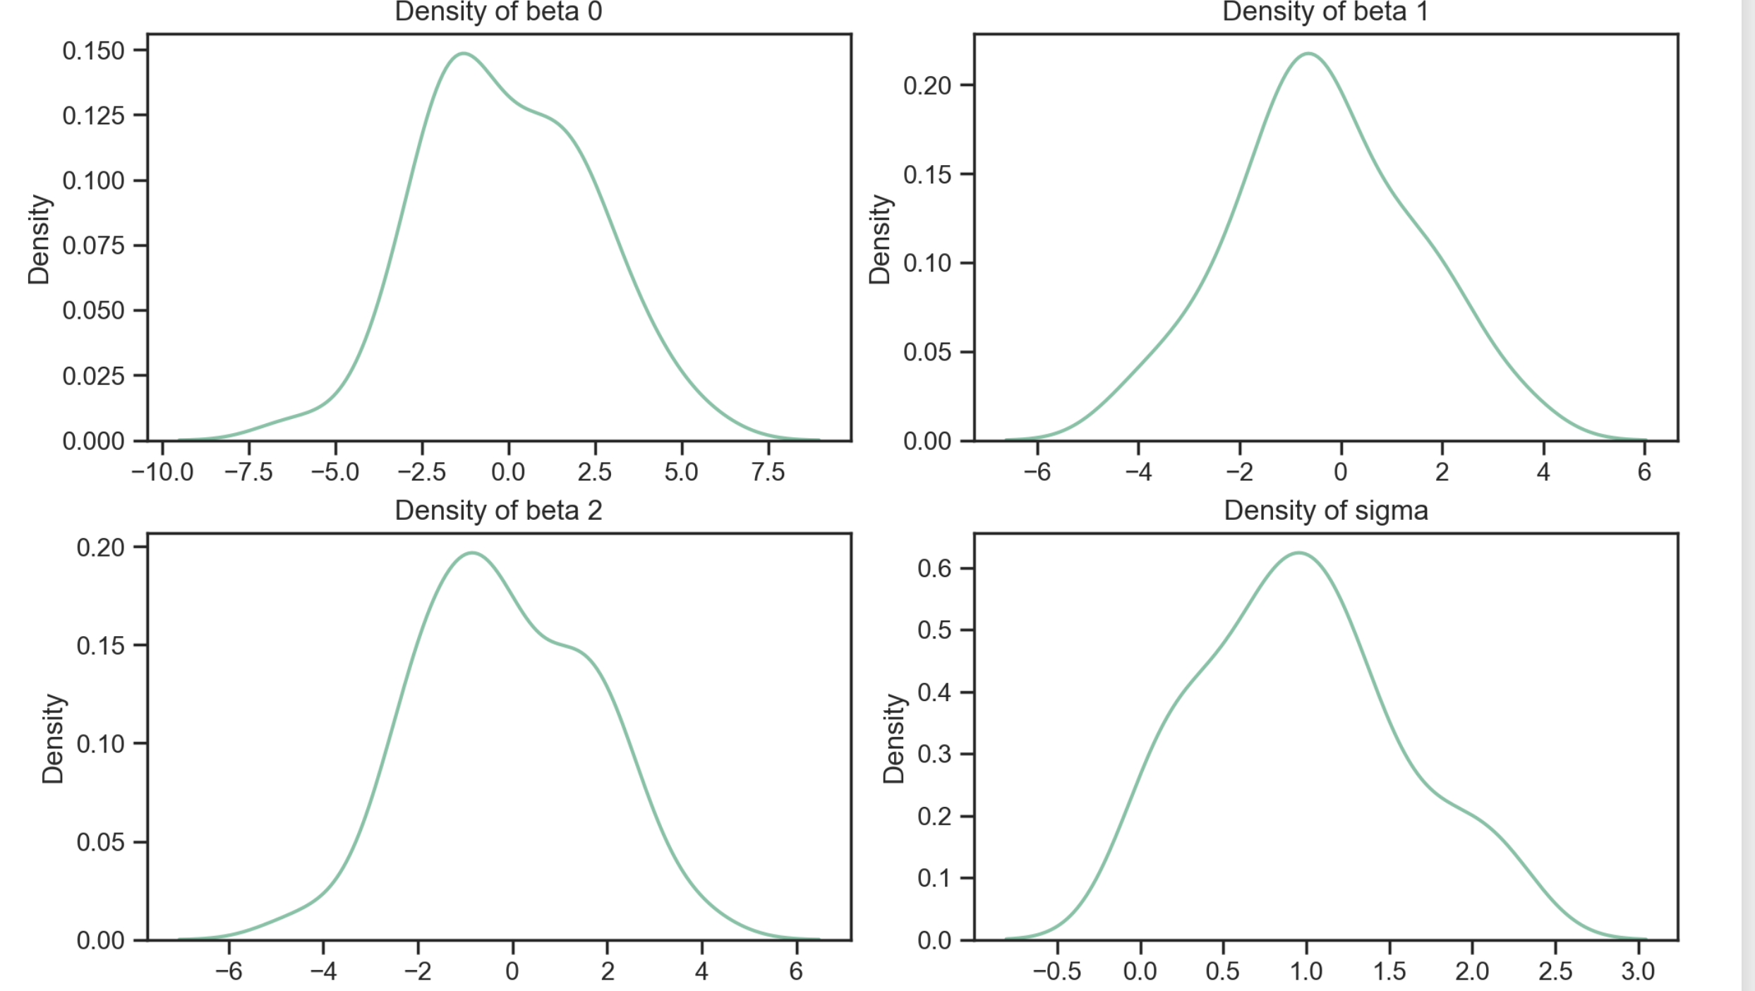
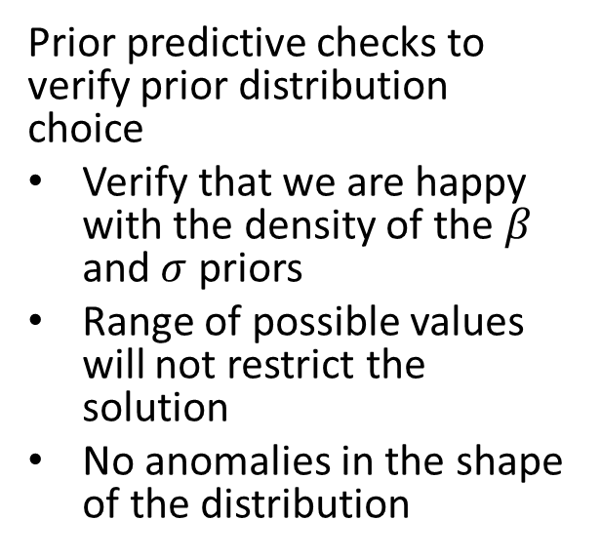
Prior Predictive Checks
Prior predictive checks to verify prior distribution choice
Verify that we are happy with the density of the $β$ and $σ$ priors
Range of possible values will not restrict the solution
No anomalies in the shape of the distribution
Prior density of Betas and sigma

Slide 57
Sampling and Inference

Slide 58
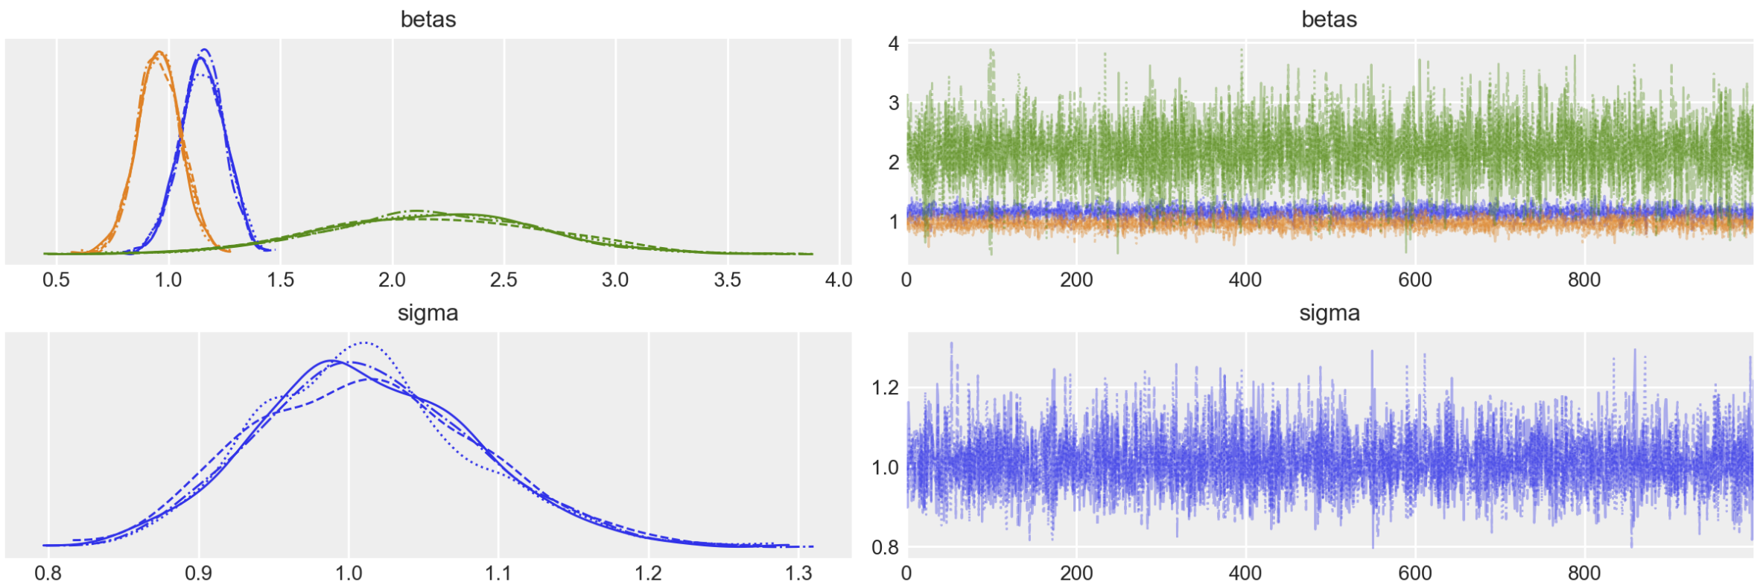
Sampling and Inference with Model
Evaluation the sampled posterior and perform inference
We sample the posterior using one or more Markov chains
Examine the traces (path of chains)
Traces and posterior density of MCMC traces

Slide 59
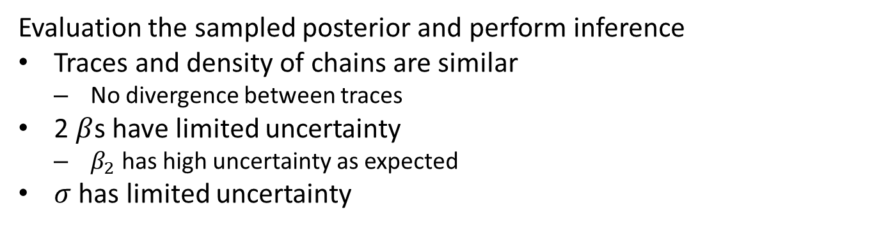
Sampling and Inference with Model
Evaluation the sampled posterior and perform inference
Traces and density of chains are similar
No divergence between traces
2 $β$s have limited uncertainty
$β_{2}$ has high uncertainty as expected
$σ$ has limited uncertainty
Traces and posterior density of MCMC traces

Slide 60
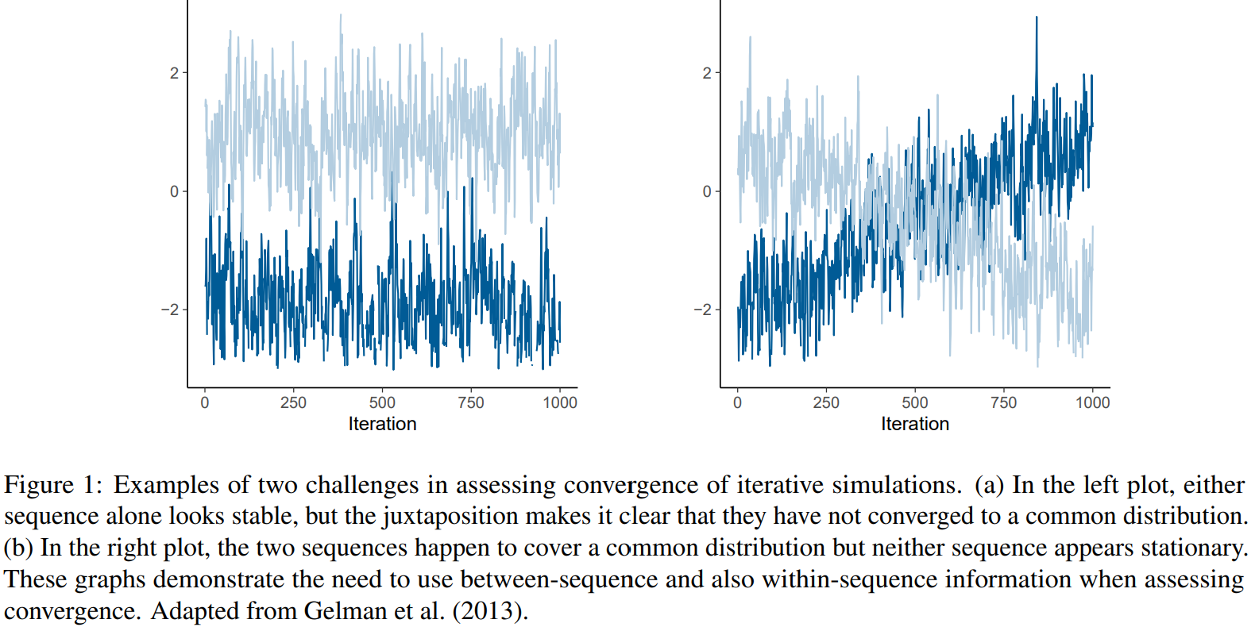
Sampling and Inference with Model
Evaluation the sampled posterior and perform inference
There are a number of ways MCMC sampling can breakdown and not converge
Example from Vehtari et.al., 2021, a seminal paper on evaluation of MCMC

Slide 61
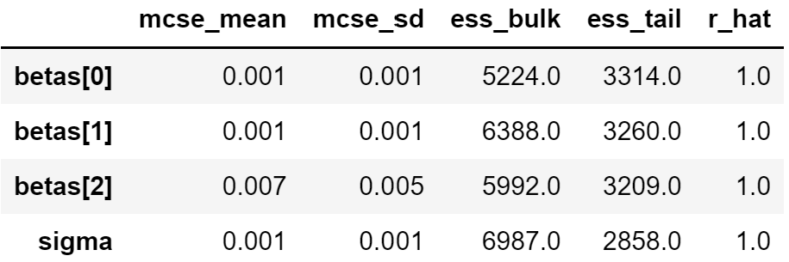
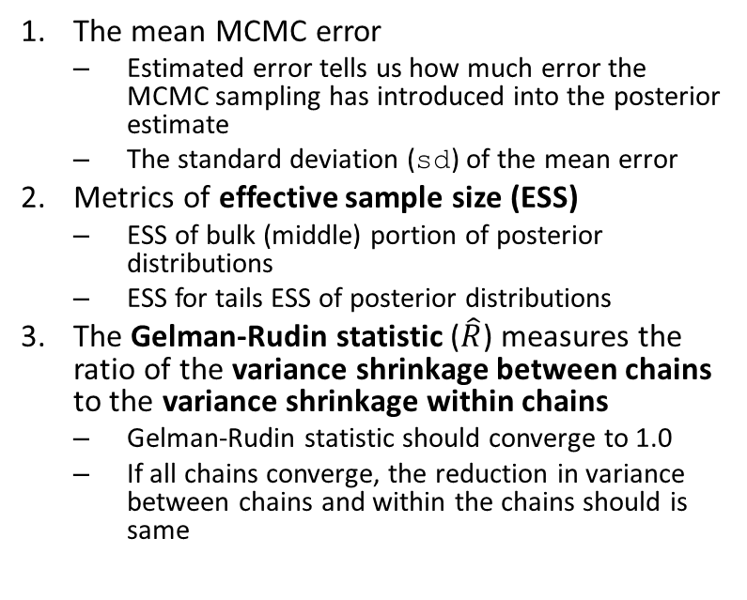
Sampling and Inference with Model
Summary table provides a lot of information to verify if samples are representative
The mean MCMC error
Estimated error tells us how much error the MCMC sampling has introduced into the posterior estimate
The standard deviation (sd) of the mean error
Metrics of effective sample size (ESS)
ESS of bulk (middle) portion of posterior distributions
ESS for tails ESS of posterior distributions
The Gelman-Rudin statistic ($\hat{R}$) measures the ratio of the variance shrinkage between chains to the variance shrinkage within chains
Gelman-Rudin statistic should converge to 1.0
If all chains converge, the reduction in variance between chains and within the chains should is same
Table of MCMC convergence statistics

Slide 62
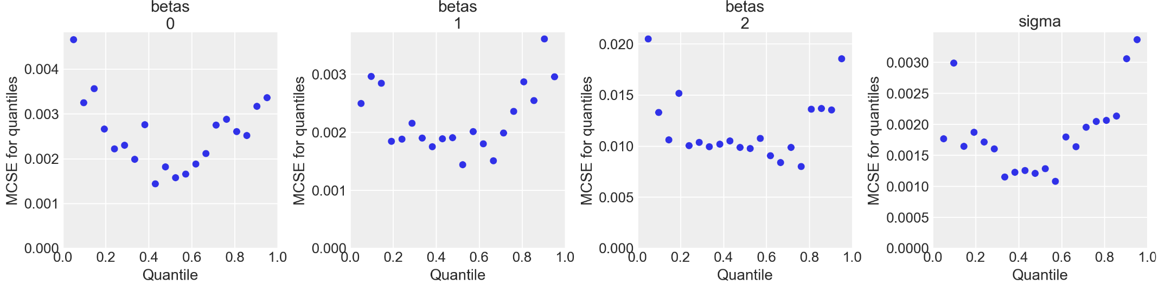
Sampling and Inference with Model
Plot the MCSE by quantile for each model parameter to verify if samples are representative
Ideally want MCSE to be small and uniform with quantile
Notice the MCSE is higher for outer quantiles
Not an unusual situation since less sampling in thin tails of distributions
Overall MCSE is low, even in tails
MCSE by quantile for each model parameter

Slide 63
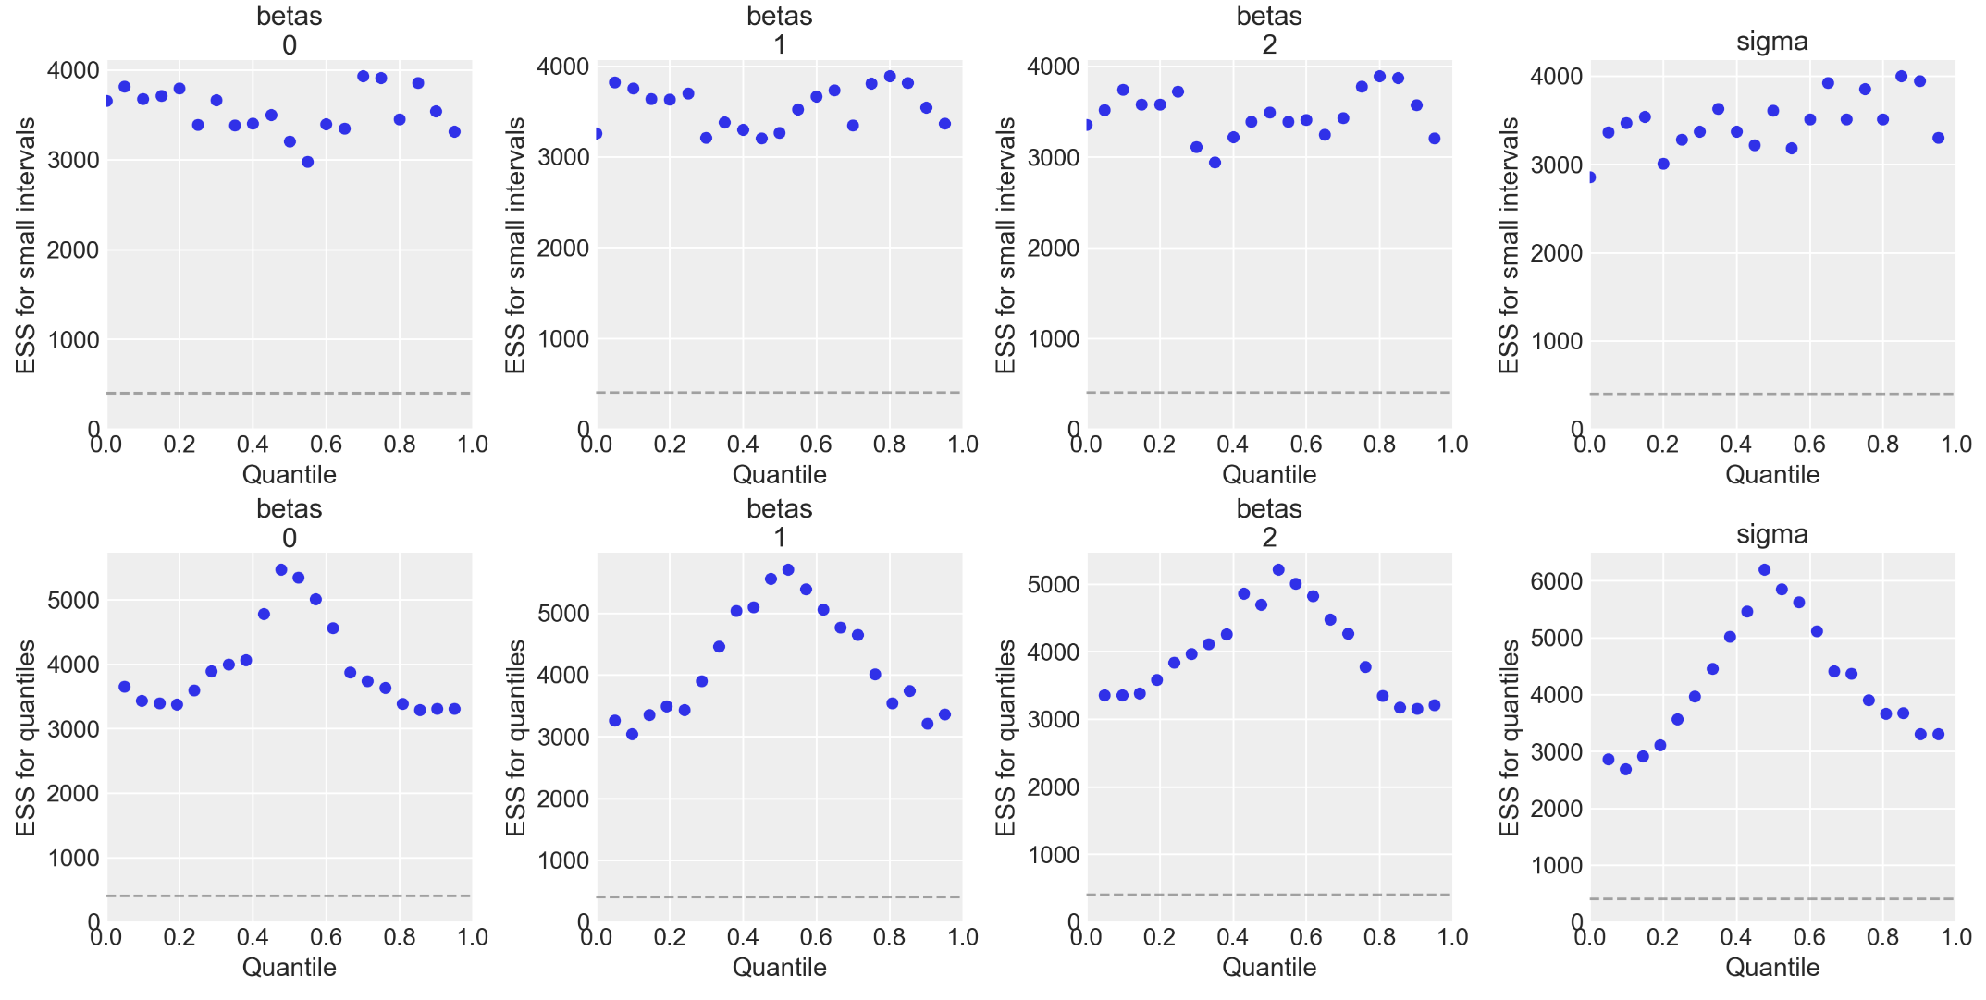
Sampling and Inference with Model
We must verify that the samples are representative
Plot the ESS locally and by quantile for each model parameter
Ideally want ESS to be large and uniform with quantile
Local ESS is fairly uniform with quantile
Notice the quantile ESS is lower for outer quantiles
Not an unusual situation since less sampling in thin tails of distributions
Overall ESS is reasonably high, even in tails
ESS locally and by quantile for each model parameter

Slide 64
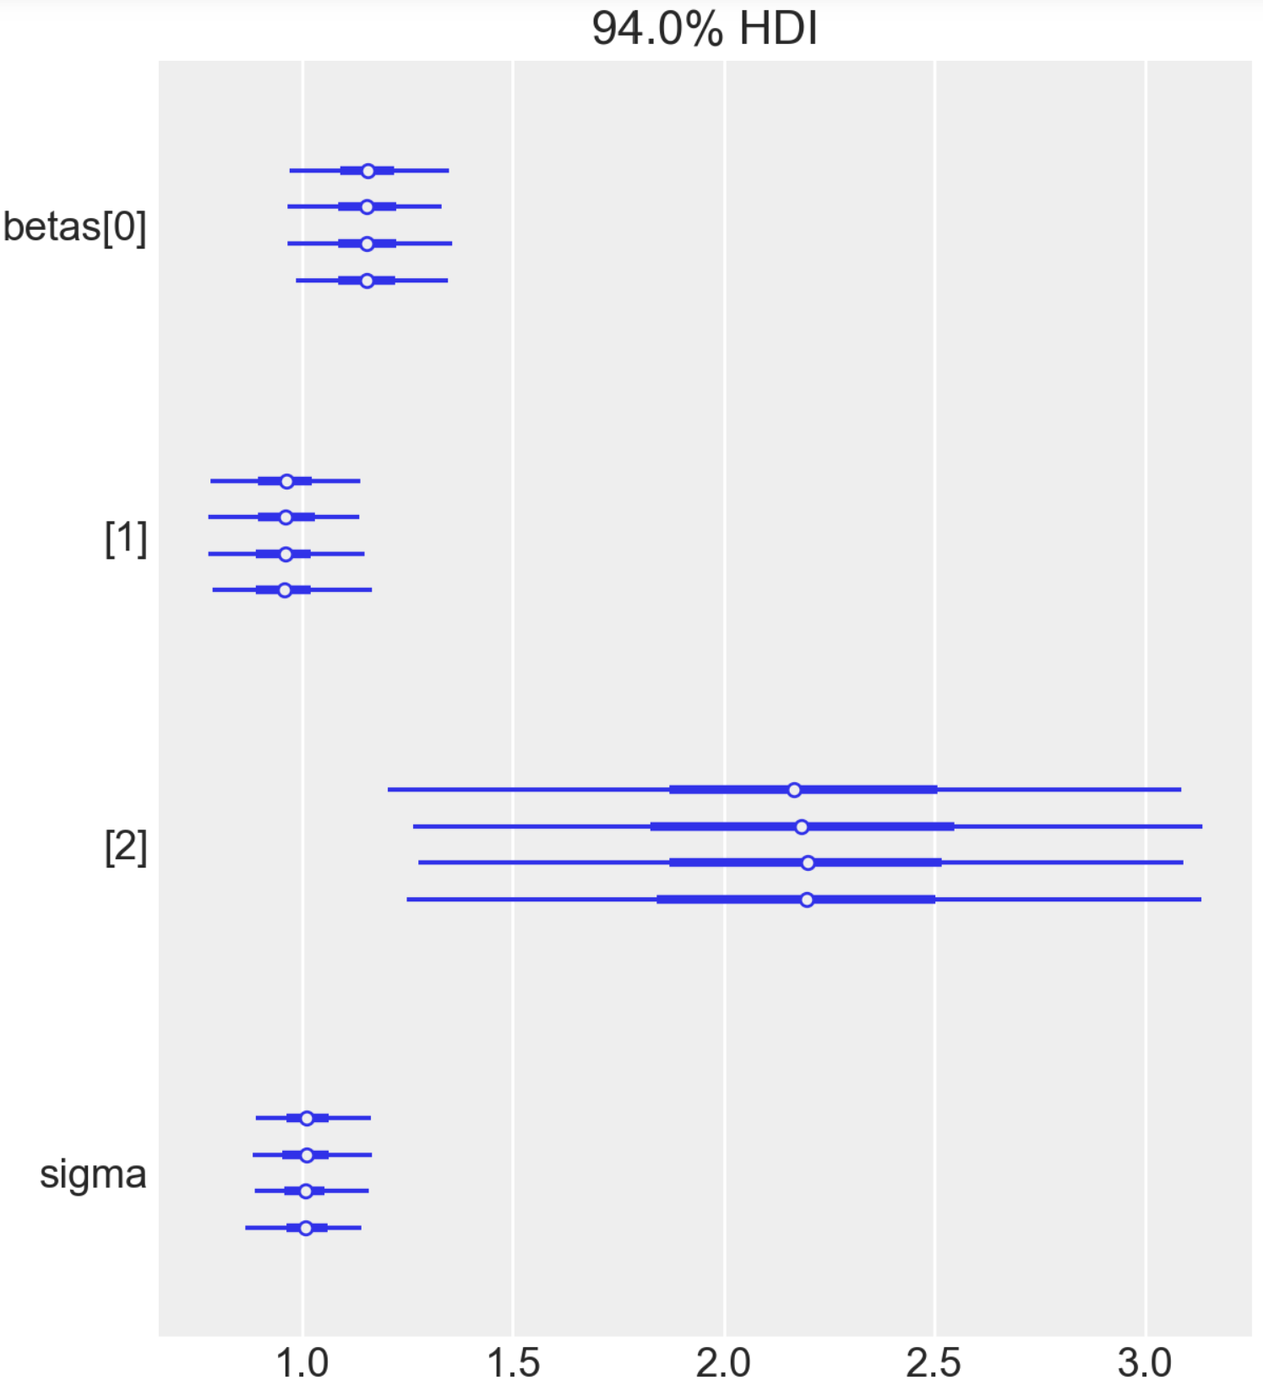
Sampling and Inference with Model
Evaluate the sampled posterior and perform inference
Examine HDIs of model parameters by trace with tree plot
HDIs are similar for each parameter by trace
HDIs confirm inferences on uncertainty of the model parameters
HDIs of model parameters by trace

Slide 65
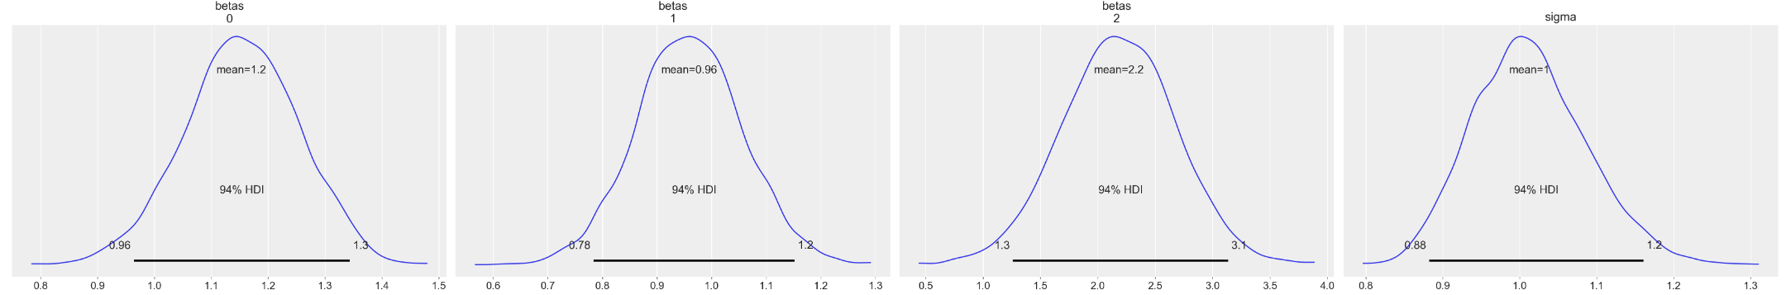
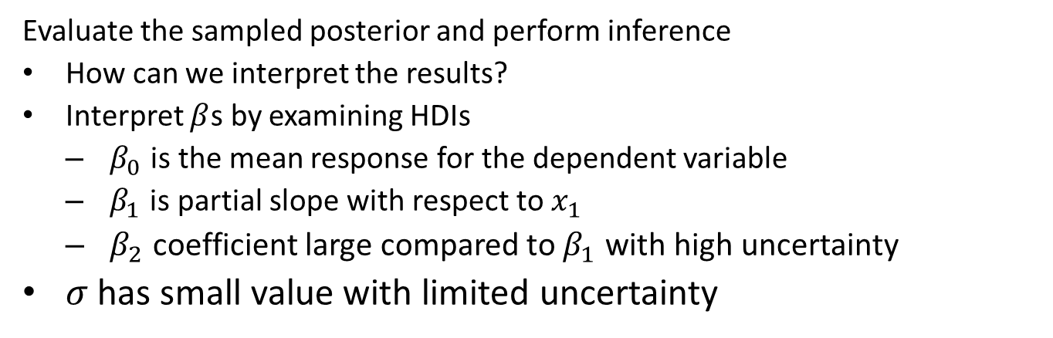
Sampling and Inference with Model
Evaluate the sampled posterior and perform inference
How can we interpret the results?
Interpret $β$s by examining HDIs
$β_{0}$ is the mean response for the dependent variable
$β_{1}$ is partial slope with respect to $x_{1}$
$β_{2}$ coefficient large compared to $β_{1}$ with high uncertainty
$σ$ has small value with limited uncertainty
Posterior distribution of parameters with HDIs

Slide 66
Posterior Predictive Checks

Slide 67
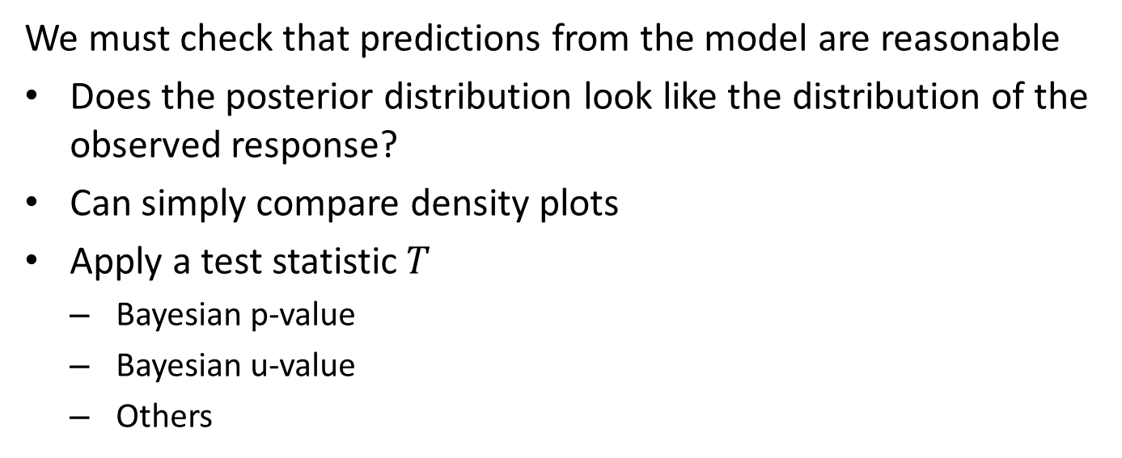
Posterior Predictive Checks
We must check that predictions from the model are reasonable
Does the posterior distribution look like the distribution of the observed response?
Can simply compare density plots
Apply a test statistic $T$
Bayesian p-value
Bayesian u-value
Others

Slide 68

Posterior Predictive Checks
We must check that predictions from the model are reasonable
Base statistic on posterior predictive distribution
Approximate PPD by resampling from the posterior distribution:
$$p\left(y^{rep}|y\right)=\sum_{i}^{​}{p}\left(y^{rep}|θ\right)p\left(θ|y\right)$$
Where: $y^{rep}=$ realization drawn from the posterior distribution $y=$ observation $p\left(y^{rep}|θ\right)=$ draw from posterior distribution with parameters $θ$ $p\left(θ|y\right)=$ posterior distribution of model parameters, $θ$
We can sample the posterior as many times as required to get better estimates of $p\left(y^{rep}|y\right)$

Slide 69

Posterior Predictive Checks
We must check that predictions from the model are reasonable
Posterior predictive distribution is compared to the distribution of observations
Agreement is generally good between posterior predictive and actual observations
Average predictive is heavier in the tails
Posterior predictive distribution vs. observed responses

Slide 70

Posterior Predictive Checks
We must check that predictions from the model are reasonable
Bayesian p-value is a test statistic, $T$, for the distribution differences between observed and predicted responses:
$$p=p\left(y^{rep}<y|y\right)$$
Intuitively, for representative posterior, $p=0.5$, over many draws of $y^{rep}$
$y^{rep}<y|y$ half the time
$y^{rep}>y|y$ half the time
Distribution should be symmetric

Slide 71

Posterior Predictive Checks
We must check that predictions from the model are reasonable
Posterior predictive Bayesian p-value
Plot is centered on 0.5
Distribution is symmetric
Distribution of Bayesian p-values

Slide 72


Posterior Predictive Checks
We must check that predictions from the model are reasonable
Posterior predictive Bayesian u-value is also known as the marginal p-value:
$$p_{i}=p\left(y_{i}^{rep}<y_{i}|y\right)$$
U-value computed for specific (ordered) observation $y_{i}$
$p_{i}$ should be centered on 1.0
$p_{i}$ should be close to uniformly distributed
The values are close to 1.0 across all values of the observations
Distribution of Bayesian u-values

Slide 73
MCMC Bayes Example 2

Slide 74
British Coal Mine Disasters
Example; analysis of change point in British coal mine disasters
Toward the end of 19th Century growing public awareness of rising coal miner deaths lead to adoption of improved safety practices
Mine disaster defined as incident leading to 6 or more deaths
As early as 1886, Royal Commission published recommendations for safety practices
Adoption of these practices remained voluntary
British Coal Mines Act of 1911 finally codified mine safety procedures into law.

Slide 75
British Coal Mine Disasters
Example; analysis of change point in British coal mine disasters
Famous dataset from Kaggle, and other sources
Goal to create a model to quantify the differences in the rate of mine disasters before and after the introduction of safety practices
Point process model has an intensity or rate of occurrence of events, e.g. mine disasters
Expected number events over a time period for this type of point process is iid
The number of events per time period from an iid draw from some probability distribution
Because of the iid nature of the point process, no autoregressive (AR) effect

Slide 76
British Coal Mine Disasters
Example; analysis of change point in British coal mine disasters
iid nature of the point process does not mean the distribution of the process cannot change in time
Change points or switch points in time are quite common in the real-world
Rates changes at change points
Rate constant between change points
Identifying these change points is a challenging problem

Slide 77

British Coal Mine Disasters
Example; analysis of change point in British coal mine disasters
Two related questions we can ask about these data
At what point in time was there a significant change in intensity, the switch point?
Not obvious, changes in safety practice were adopted over about 25 years
How significant was the reduction in the rate?
Number of disasters per year 1851-1962

Slide 78

British Coal Mine Disasters
Example; analysis of change point in British coal mine disasters
Poisson likelihood model for intensity with switch point $s$, rate before, $e$ and rate after $l$:
$$D_{t}∼Pois\left(r_{t}\right), { r}_{t}=\left\{\begin{matrix}e, t<s \\ l, t≥s\end{matrix}\right.$$
Prior distributions of parameters, uniform and exponential:
$$s\sim unif\left(t_{min},t_{max}\right)$$
$$e\sim \exp\left(2\right)$$
$$l\sim exp⁡(2)$$

Slide 79
British Coal Mine Disasters
Example; analysis of change point in British coal mine disasters
Define model using PyMC
with pymc.Model() as disaster_model: # Uniform prior on the switch point switchpoint = pymc.DiscreteUniform("switchpoint", lower=disaster_data.Year.min(), upper=disaster_data.Year.max()) # More informative priors based on domain knowledge # switchpoint = pymc.Triangular("switchpoint", lower=disaster_data.Year.min(), upper=disaster_data.Year.max(), c=1900) # switchpoint = pymc.Laplace("switchpoint", mu=1900, b=4.0) # Priors for pre- and post-switch rates early_rate = pymc.Exponential("early_rate", 2.0) late_rate = pymc.Exponential("late_rate", 2.0) # Poisson rate switch for years before and after current rate = pymc.math.switch(switchpoint >= disaster_data.Year, early_rate, late_rate) disasters = pymc.Poisson("disasters", rate, observed=disaster_data.Count)

Slide 80

British Coal Mine Disasters
Example; analysis of change point in British coal mine disasters
Good agreement between traces
Distributions of variables from sampling
HDI of parameters by trace

Slide 81

British Coal Mine Disasters
Example: analysis of change point in British coal mine disasters
Examine the posterior HDI of the parameters for each trace
The HDIs are consistent across traces
The early and late rates have a statistically significant difference
HDI of switch point spans about 10 years
See notebook for MCMC, Prior and Posterior checks
HDI of parameters by trace

Slide 82

British Coal Mine Disasters
Example; analysis of change point in British coal mine disasters
Examine the posterior HDI of the parameters
HDI of switch point is in reasonable range over about 10-year period
Significant difference in HDI of rates
Posterior distribution of parameters with HDI

Slide 83

British Coal Mine Disasters
Example; analysis of change point in British coal mine disasters
Posterior Predictive checks
The predicted vs actual plot shows good agreement
Bayesian p-value and u-value for posterior show desired characteristics
Posterior predictive checks

Slide 84
Summary
For complex Bayesian models we need a computationally efficient approximation
Grid sampling is inefficient
MCMC sampling is based on Markov chains
Markov process is memoryless
Sampling converges to probability distribution
Several MCMC sampling methods have been developed
Metropolis-Hastings (M-H) algorithm uses random sampling with acceptance probability
Gibbs sampling round robins on the dimensions of the parameter space
NUTS is a robust variation on Hamiltonian Monte Carlo
NUTS is the state of the art MCMC algorithm
Based on Hamiltonian Monte Carlo using an auxiliary variable to map the potential highest density parts of the posterior parameter space
No hyperparameters to tune
Notes:
pos

Slide 85
Summary
Performance metrics of MCMC sampling
Sample efficiency
Serial correlation reduces sample efficiency
ESS
Convergence
Multiple chains should converge to the similar distributions
Want between chain and within chain variance to be the same

